Slide 1
Schulich Ignite 2020

Slide 2
Session Overview
Functions

Slide 3
Functions

Slide 4
Functions
Functions package code together into a reusable chunk with a name
They let you split up your program into many smaller parts
They make life easier by letting you reuse code, so that you don’t need to write the same things over and over again

Slide 5
Examples of functions
Take a vending machine for example.
It has a few different simple functions that need to be repeated over and over:
Take in money and count it
Take in the person’s choice of food
Dispense the chosen item if there is enough money

Slide 6
Pre-Defined Functions
So far, we’ve been using functions like commands:
print("Hello World") # print something
ellipse(200, 300, 50, 50) # draw an ellipse
fill(200, 120, 50) # change the fill colour
They just do some single action for us

Slide 7
Return Values
Some other functions give us back a return value
# returns the larger of the two numbers
max_value = max(11, 13) # returns the length of a list
list_length = len(my_list)
# returns a random num between 0 and 10 random_number = random(10) # returns a sorted copy of the list
sorted_list = sort(my_list)
Notes:
Show more examples of functions being used in place of values and variables

Slide 8
Making our own functions
We can create our own functions too! Here is the anatomy of a function:
def name(parameters):
# function body
return value
Function checklist:
name | REQUIRED
body | REQUIRED
parameters | optional
return value | optional

Slide 9
Function Names
All functions have a name.
This is what we use to call our function
def name (parameters):
# function body
return value

Slide 10
Function Body
All functions have a body.
This is where we say what the function actually does
(This is where you put the code!)
def name(parameters):
# function body
return value

Slide 11
Simple Example
This is the simplest type of function. It just does something. No parameters, no return value needed.
The name is greeting
The body is one line: print("Hello everyone!")
def greeting():
print("Hello everyone!")
def setup():
# Call our function greeting()
setup() is actually a function too!
Notes:
More examples of functions:
draw()
setup()
noStroke()
noFill()
println()

Slide 12
Function Parameters
Functions can also take in parameters. These are the values supplied to a function that then become variables for that function
def name( parameters ):
# function body
return value

Slide 13
Parameters Example
This is a function that says hello to someone
It takes in one parameter
def greet_me(name):
print("Hello " + name)
Notes:
max()

Slide 14
Parameters Example
This is a function that adds two numbers together
It takes in two parameters
It returns the sum of the two inputs
def add(a, b): sum = a + b
print(sum)
Notes:
max()

Slide 15
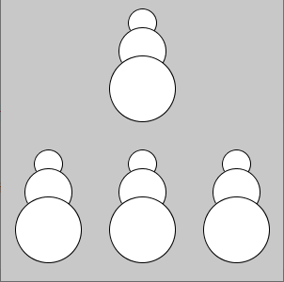
Exercise 1: Drawing a Snowman
Create a function called draw_snowman that draws a simple snowman on screen
Use circle() 3 times inside draw_snowman
The function should take the following parameters as inputs:
x-coordinate
y-coordinate
Call the function inside draw()
(Feel free to draw something other than a snowman too!)
Notes:
def setup():
size(400, 400)
draw_snowman(80, 100)
draw_snowman(320, 100)
draw_snowman(200, 200)
def draw_snowman(x, y):
fill(255, 255, 255)
ellipse(x, y, 50, 50)
ellipse(x, y + 40, 70, 70)
ellipse(x, y + 100, 90, 90)

Slide 16
Return values
Some functions can have a return value This is what the function passes back
def name(parameters):
# function body
return value
Return values can be anything, such as a number or a string

Slide 17
Return Example
These are functions with a return value
It just returns an integer
It doesn’t take in any parameters
def get_my_age():
return 20
def two_plus_two():
answer = 2 + 2
return answer

Slide 18
Another Example
def setup():
volume = calculate_cube_volume(2) print("A cube with side length 2 has volume:")
print(volume)
def calculate_cube_volume(sideLength):
return sideLength * sideLength * sideLength

Slide 19
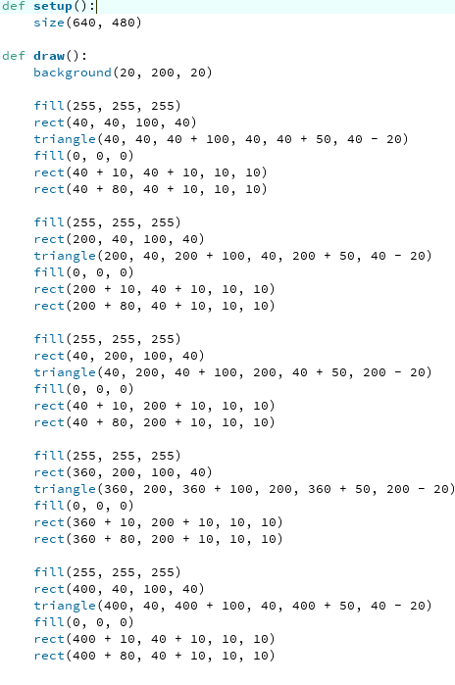
Why even use functions?
What if we wanted to draw a simple town, with a lot of houses on our screen? Let’s see what that would look like without using functions

Slide 20
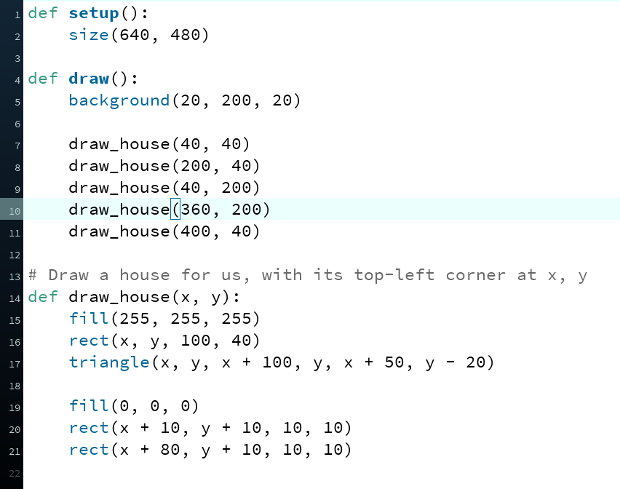
Why even use functions?
Let’s look at that same example with functions. We can make our code much nicer and easier to read if we use functions!
Using functions is great if we want to repeat the same few lines of code, but only changing a few variables each time!

Slide 21
Functions are Great for Changing Inputs
def draw(): background(0, 0, 0)
set_color(mouseX)
circle(300, 300, 300)
def set_color(x): if x > 400:
fill(200, 20, 20)
elif x > 200:
fill(20, 200, 20)
else:
fill(20, 20, 200)
Notes:
def setup():
size(600, 600)
def draw():
background(0, 0, 0)
set_color(mouseX)
circle(300, 300, 300)
def set_color(x):
if x > 400:
fill(200, 20, 20)
elif x > 200:
fill(20, 200, 20)
else:
fill(20, 20, 200)

Slide 22
Exercise 2: Tying it all Together
Create a function called draw_dartboard that draws a dartboard on the screen
Design the function draw_dartboard so that it takes the following parameters as inputs:
Location of the dartboard (x & y coordinates)
Diameter of the dartboard
Hint: Use a while loop inside of your draw_dartboard function to draw the different rings!
Notes:
def setup():
size(600, 600)
def draw():
background(0, 0, 0)
draw_dartboard(300, 400, 6)
draw_dartboard(200, 200, 10)
draw_dartboard(500, 500, 3)
def draw_dartboard(x, y, rings):
fill(255, 255, 255)
i = rings
while i >= 0:
circle(x, y, 25 + 20 * i)
i -= 1

Slide 23
Using global in functions
Just like in draw() and setup(), if we want to use other variables inside our own functions, we can use global!
shopping_list = [“Apples”, “Oranges”, “Basketballs”]
def setup():
print_list()
def print_list():
# Tell processing that shopping_list is from outside of our function
global shopping_list
for item in shopping_list:
print(item)

Slide 24
You’re done!
What’s Next?

Slide 25
All about projects!
Projects are optional
Up to 250 Ignite Points can be earned for one project!
Deadline for projects is September 11th at 11:59PM
Projects will be marked based on 5 categories: readability, efficiency, novelty, functionality and complexity (up to 50 points for each category)

Slide 26
All about projects!
Project rubric and each category description can be found in the Ignite Point spreadsheet: https://docs.google.com/spreadsheets/d/1hSNFLSHZPwLeb6MjDPZ_KntGLAOWSQN5qY9DEahpycg/edit?usp=sharing
The process for submitting your files does not change. Submit projects here: https://forms.gle/7TH3dJpc4JzGiDzz9
You can submit as many projects as you would like till the deadline

Slide 27
Gala event (DATE TBD)
Interact with industry speakers!
Showcase your projects in the main room to industry speakers, mentors and the rest of the class
Invite family and friends
Please fill out this survey to show interest in attending: https://forms.gle/151GYj5g5JiCUMoW6

Slide 28
ADDITIONAL INFORMATION
If you want to present a project during the Gala event, make sure to have your project ready for presentation by the day of the Gala event
If you need help with your project, join us on Discord
Ask questions to mentors (we’re available for the next 2 weeks)
Show off your work
If you would like your project to get a shout-out on our social media pages, let your mentor know and we will take care of the rest!

Slide 29
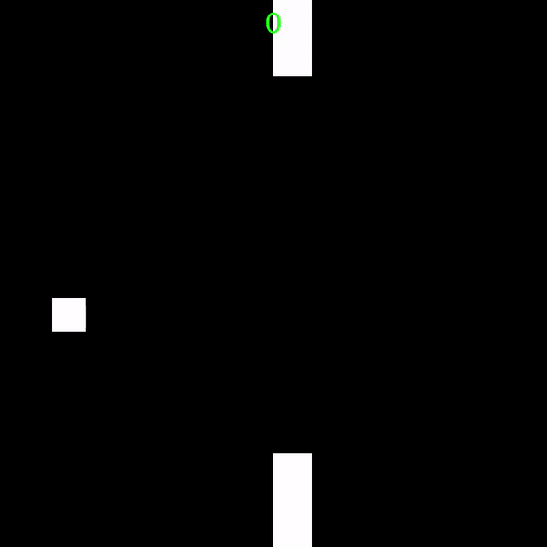
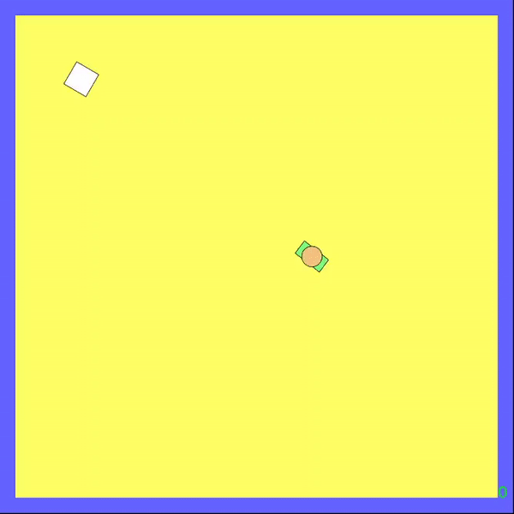
Some Project Inspiration
See the code on our Google Drive
Notes:
All our code, including these games, can be found here: https://drive.google.com/drive/folders/1k8xJLldARqkg6CHAYL6SwZnQ2WHh0PAq?usp=sharing

Slide 30
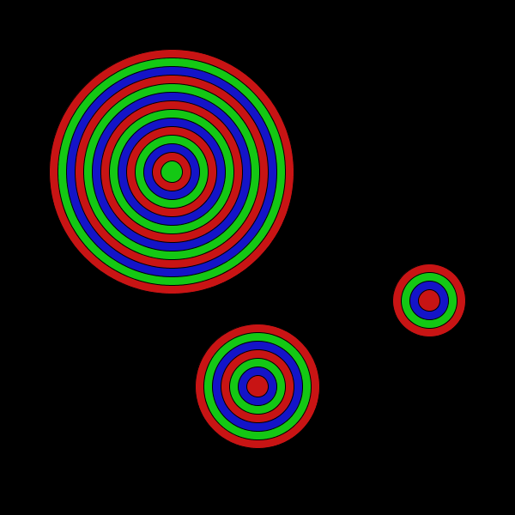
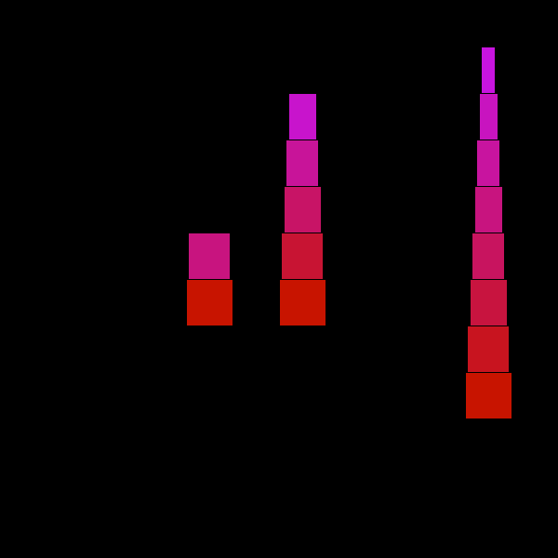
More things to do!
25
1
2
3
Note: You must make your own functions to draw the objects for full marks!
Hint: For #3, you need to use float() on the numbers before dividing them to get the color: fill(255, 255, float(i) / float(num))

