Slide 1
Schulich Ignite 2020

Slide 2
Session Overview
For in range loops
While loops
Getting inputs
Examples - Lots of Practice!

Slide 3
Loops continued
Notes:
You guys already have been using loops, Draw is in fact a loop. It’s something that runs over and over and over again, which sounds a lot like draw. But sometimes we need our own loop for our own purposes.

Slide 4
What Is Range?
Range is a list of numbers from 0 to 1 less than the number you give it
range(9) # [0, 1, 2, 3, 4, 5, 6, 7, 8] - Not 9!
x = 6
range(x) # [0, 1, 2, 3, 4, 5] - Not 6!

Slide 5
Using range with loops
Range is very convenient if we want to repeat code, but we don’t need to use any variables from a list.
For example, if we wanted to just print “Hi!” 6 times, we could write
for i in range(6): print(“Hi!”)

Slide 6
Using range with loops and multiple lists
Another great place for range is if we need to use multiple lists. What if we wanted to draw many circles, and each has a different size? How do we use both lists?
balls = [100, 200, 300, 400] sizes = [20, 30, 40, 20]
# We use a range of 4 since we have a list of 4 balls for i in range(4): circle(balls[i], 100, sizes[i])

Slide 7
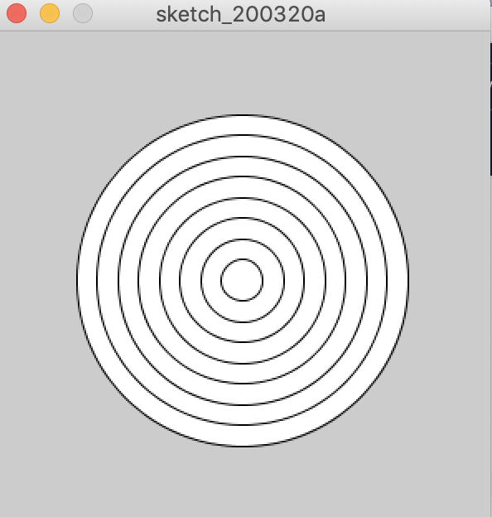
Why Is It Useful?
Remember the dartboard example from last week?
What if we wanted every ring to have a different color?

Slide 8
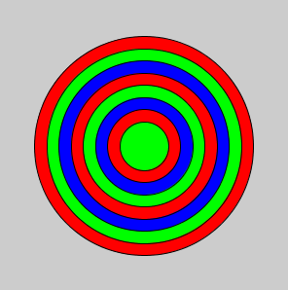
How do we use it?
r = color(255, 0, 0)
g = color(0, 255, 0)
b = color(0, 0, 255)
sizes = [225, 200, 175, 150, 125, 100, 75, 50]
colors = [ r, g, b, r, g, b, r, g]
for i in range(8):
fill(colors[i])
circle(150, 150, sizes[i])

Slide 9
While loops
Another kind of loop is while loop while condition == True:
# Do something here
A while loop works kind of like a repeating if statement
As long as the boolean expression is True, the code inside will be repeated!
Notes:
Here is the form of a while loop. You guys are familiar to when we should stop the loop. While a condition is true than we do something.
Again we have curly brackets in between to tell it what we want it to do.

Slide 10
How do we use them?
For example, if we wanted to make a simple loop that counts to 10
i = 1 while i != 10: print(i) i += 1
This loop will run as long as i is not equal to 10.
Notes:
Consider this problem! We must ask ourselves, at what point do we stop looping?

Slide 11
How do we use them?
In this example, what would happen if we removed the line that said: i += 1?
i = 1 while i != 10: print(i) # i += 1 <- Remove this line! What does our loop do now? Does it do what we would expect?
Notes:
Consider this problem! We must ask ourselves, at what point do we stop looping?
If we remove i += 1, then i will never change. Since i equals 1, i != 10 is always true!
This is what we call an “infinite loop” (and usually they’re bad things)

Slide 12
How do we use them?
10
Let’s take the previous example, and change it to add 2 to i every time instead of 1?
i = 1 while i != 10: print(i) i += 2
Will this work? Why or why not? What will happen?
Notes:
Instead of having i += 1, if we chose i += 2, i would equal:
1, 3, 5, 7, 9, 11, 13, 15, 17…
Notice that i != 10 is always true again, and we have another infinite loop!
Using i < 10 can safeguard us from this.

Slide 13
How are while loops useful?
Like for loops, while loops are a great for repeating code and using multiple lists! Let’s use them to draw a few circles with different positions and sizes again!
i = 0 positions = [100, 200, 300, 400] sizes = [10, 20, 30, 40]
# Remember, since lists start at index 0, we need our loop # to go from i = 0, all the way up to i = 3 while i < 4: circle(positions[i], 100, sizes[i]) i += 1

Slide 14
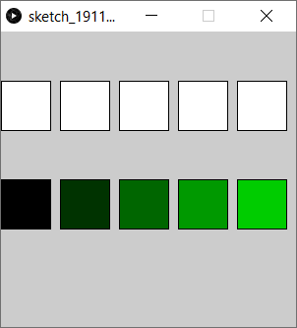
Exercise 1:Fancy Squares
Use a while loop to display 5 evenly spaced squares (Hint: the x position will depend on the loop counter)
Add another while loop to make squares with colours! (Hint: the red/green/blue values will depend on the loop counter)
Notes:
def setup():
size(600, 600)
for i in range(5):
square(i * 50 + i * 10 + 10, 40, 50)
for i in range(5):
fill(0, i * 255/5, 0)
square(i * 50 + i * 10 + 10, 100, 50)

Slide 15
Inputs

Slide 16
Status Values
mousePressed - A boolean value that is True when a mouse button is pressed
keyPressed - A boolean value that is True when any key is pressed on the keyboard

Slide 17
mousePressed Example
if mousePressed: # These are all global Variables r += 3 g += 10 b += 25 fill(r, g, b) circle(500, 500, 500)
Notes:
r = 25
g = 5
b = 0
def setup():
size(1000, 1000)
def draw():
background(255)
global r, g, b
if mousePressed:
r += 3
g += 10
b += 25
fill(r, g, b)
circle(500, 500, 500)

Slide 18
mouseButton
mouseButton checks for left click or right click. This example changes colour depending on which button you choose
if mousePressed and mouseButton == LEFT: fill(0, 255, 0) elif mousePressed and mouseButton == RIGHT: fill(255, 0, 0) circle(mouseX, mouseY, 50)

Slide 19
keyPressed Example
# draw_circle and draw_square are global if keyPressed and not draw_circle: draw_circle = True draw_square = False elif keyPressed and not draw_square: draw_circle = False draw_square = True if draw_circle: circle(500, 500, 500) if draw_square: square(250, 250, 500)
Notes:
draw_circle = True
draw_square = False
def setup():
size(1000, 1000)
def draw():
background(255)
fill(0)
global draw_circle, draw_square
if keyPressed and not draw_circle:
draw_circle = True
draw_square = False
elif keyPressed and not draw_square:
draw_circle = False
draw_square = True
if draw_circle:
circle(500, 500, 500)
if draw_square:
square(250, 250, 500)

Slide 20
Key
key - A string that represents which letter or number has been pressed (arrow keys, shift and other “special” keys have a different variable)
So if you press the ‘a’ key on your keyboard then:
key == “a” # This would be True

Slide 21
key example
textSize(32) textAlign(CENTER)
if key != " ": # Not Spacebar text(key, 500, 500)
else: text("<space>", 500, 500)
Notes:
def setup():
size(1000, 1000)
def draw():
background(0)
textSize(32)
textAlign(CENTER)
if key != " ":
text(key, 500, 500)
else:
text("<space>", 500, 500)

Slide 22
CODED and Key Codes
CODED - A value that key is set to when the key that is pressed is not a letter or number (i.e. arrow keys, shift etc.)
keyCode - can be used to check keys that are not numbers or letters (you should always check if key == CODED before checking the keyCode)
For example if you press the up arrow then: key == CODED and keyCode == UP

Slide 23
CODED and Key Code example
Remember y = 0 is at the top, so subtracting makes the ball go up!
if keyPressed: if key == CODED: if keyCode == UP: y -= 5 if keyCode == DOWN: y += 5 if keyCode == LEFT: x -= 5 if keyCode == RIGHT: x += 5 circle(x, y, 100)
Notes:
x = 500
y = 500
def setup():
size(1000, 1000)
def draw():
global x, y
background(0)
if keyPressed:
if key == CODED:
if keyCode == UP: # Remember y starts at 0
y -= 5
if keyCode == DOWN:
y += 5
if keyCode == LEFT:
x -= 5
if keyCode == RIGHT:
x += 5
circle(x, y, 100)

Slide 24
Exercise 2:Simple paint
Make a simple paint program!
Pressing buttons on the keyboard should let you change between colors. Use at least 3 different colors!
Bonus: Make it so that the space bar clears the screen, and that right clicking “erases”!
Notes:
draw_color = color(255, 0, 0)
def setup():
size(800, 800)
background(0, 0, 0)
def draw():
global draw_color, color_name
if mousePressed:
if mouseButton == LEFT:
fill(draw_color)
else:
fill(0, 0, 0)
noStroke()
circle(mouseX, mouseY, 50)
if keyPressed and key != CODED:
if key == '1':
draw_color = color(255, 0, 0)
elif key == '2':
draw_color = color(0, 255, 0)
elif key == '3':
draw_color = color(0, 0, 255)
elif key == ' ':
background(0, 0, 0)

Slide 25
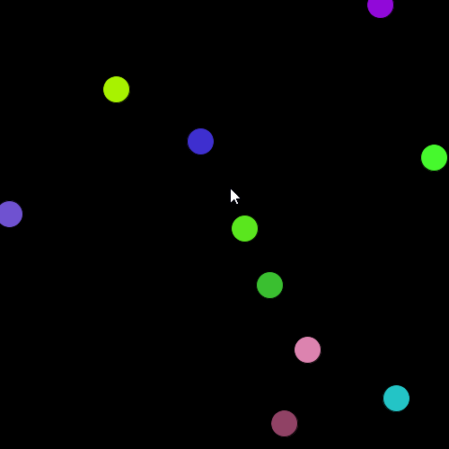
More things to do!
50
1
2
The balls should follow the mouse while clicking
Screensaver, but new balls are added when clicking

Slide 26
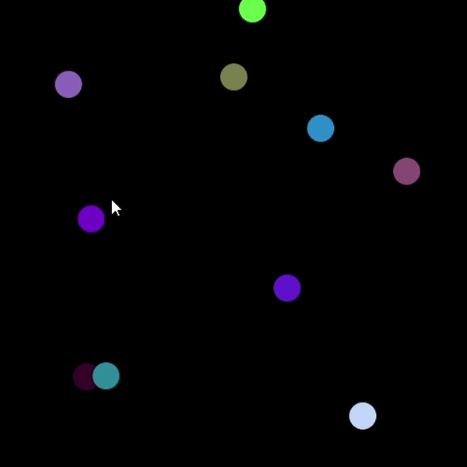
More things to do!
50
Similar to #1, but with more advanced physics!
3

