Slide 1
Schulich Ignite 2020

Slide 2
Session Overview
Review of if/elif/else
Reviewing logical expressions
Intro to lists
Intro to loops

Slide 3
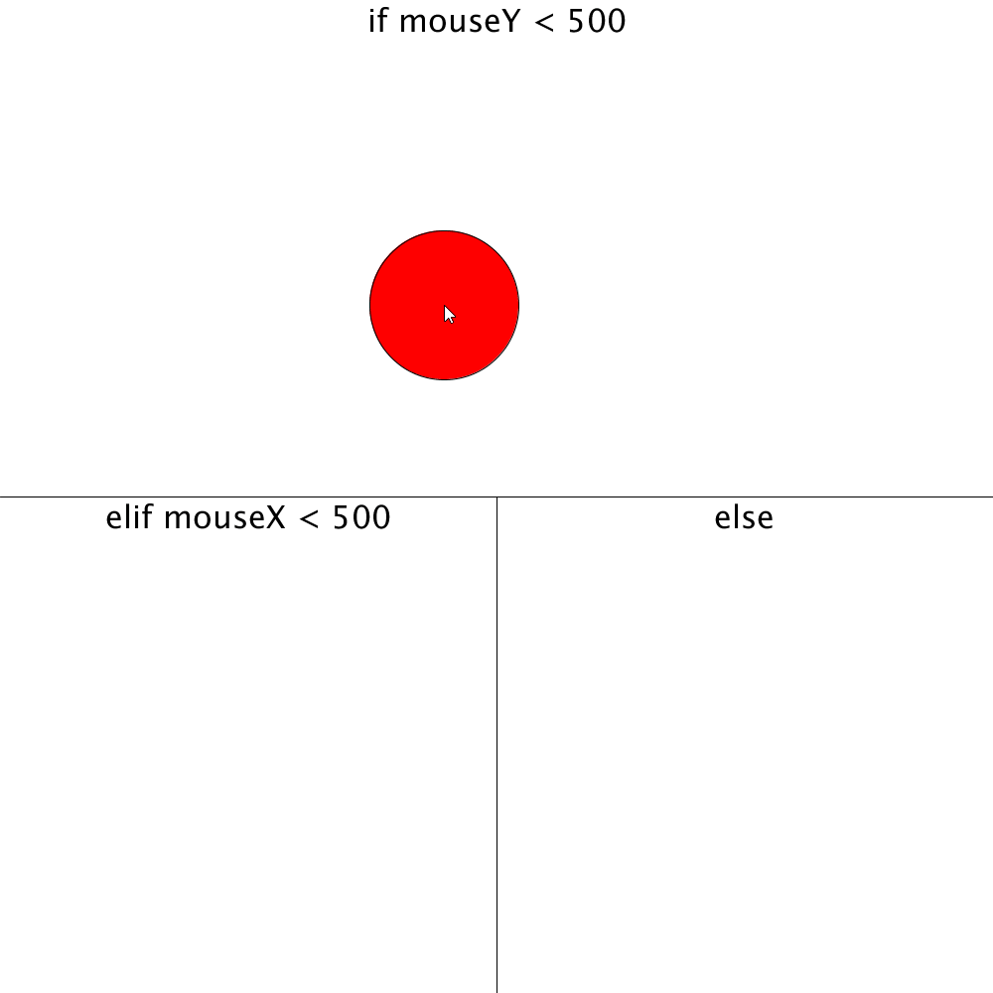
if … else if … else Statement
if mouseY > 500: # Top Half of the screen fill(255, 0, 0) elif mouseX < 500: # Lower left half of screen fill(0, 255, 0) else: # Lower right half of screen fill(0, 0, 255)
circle(mouseX, mouseY, 150)
Notes:
# Draws a Venn Diagram to illustrate if, elif and else
def setup():
size(1000,1000)
def draw():
background(255) # Draw White Background
line(0, 500, 1000, 500) # Draw line from (0,500) to (1000, 500)
line(500, 500, 500, 1000) # Draw line from (500, 500) to (500, 1000)
if mouseY < 500: # Top Half of the screen
fill(255, 0, 0)
elif mouseX > 500: # Lower left half of screen
fill(0, 255, 0)
else: # Lower right half of screen
fill(0, 0, 255)
circle(mouseX, mouseY, 150) # Draw Circle at (mouseX, mouseY) with Radius = 150
# Text labels to make it easier to understand
fill(0) # Make Text black
textSize(32)
textAlign(CENTER)
text("if mouseY < 500", 500, 32)
text("elif mouseX > 500", 250, 532)
text("else", 750, 532)

Slide 4
Logical expressions
The statement “Programming is fun AND useful” is true, because programming is fun as well as useful!
The statement “At 22°C, water is a liquid AND a solid” is false, since water is not a solid at this temperature
But the statement “At 22°C, water is a liquid OR a solid” is true, since water is ONE of those things (a liquid)

Slide 5
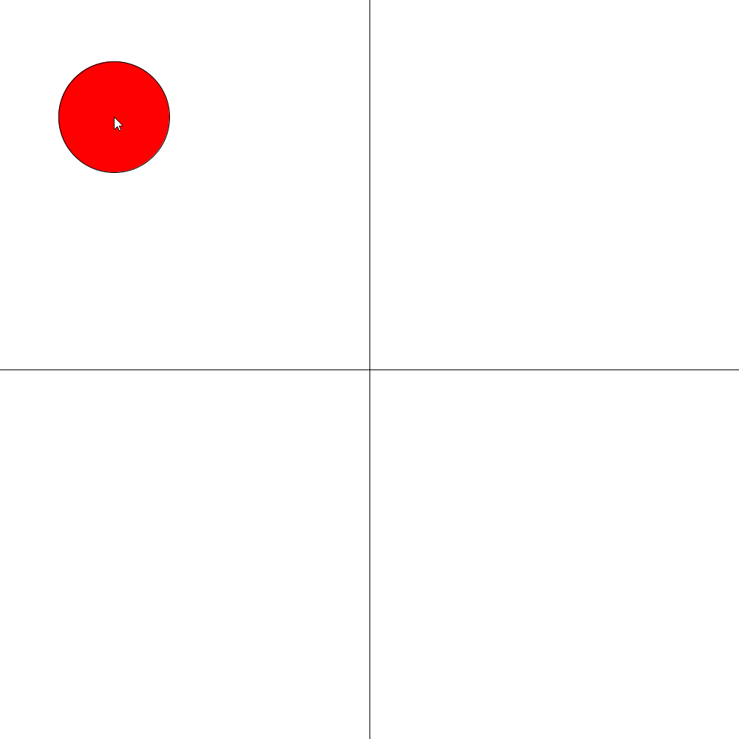
Logical Expressions (not + And) Example
# Don't need to be global because they reset every time
top = mouseY < 500
bottom = mouseY > 500
right = mouseX > 500
left = mouseX < 500
# Colours
if top and left:
fill(255, 0, 0)
elif bottom and right:
fill(0, 255, 0)
else:
fill(0, 0, 255)
# Shapes
if right and not bottom:
square(mouseX, mouseY, 150)
else:
circle(mouseX, mouseY, 150)
Notes:
# Creates a grid that changes colour and shape based on position of mouse
def setup():
size(1000,1000)
def draw():
background(255)
# Guiding lines to make things easier to see
line(500, 0, 500, 1000)
line(0, 500, 1000, 500)
# Don't need to be global because they reset every time
top = mouseY < 500
bottom = mouseY > 500
right = mouseX > 500
left = mouseX < 500
# Colour changes
if top and left:
fill(255, 0, 0)
elif bottom and right:
fill(0, 255, 0)
else:
fill(0, 0, 255)
# Shape changes
if right and not bottom:
square(mouseX, mouseY, 150)
else:
circle(mouseX, mouseY, 150)

Slide 6
Exercise 0: Bouncing Back (Review)
Draw a circle that moves to the right and bounces (i.e. changes directions when it hits an edge of the window.
Hint: Ask your mentors questions!
Notes:
radius = 20
speed = 3
x = radius + 1
def setup():
size(400, 200)
ellipseMode(RADIUS)
def draw():
global radius, speed
background(0)
ellipse(x, radius, radius, radius)
if x <= radius or x >= width - radius:
speed *= -1
x += speed

Slide 7
Exercise 0.5: ScreenSaver (Review)
Make the circle from Exercise 0 start in a random direction and bounce like a screensaver.
Hint: Ask your mentors questions!
Notes:
x = 250
y = 50
xVel = 5
yVel = 5
def setup():
global x, y
size(600, 600)
# Start in random position
x = random(100, 500)
y = random(100, 500)
def draw():
global x, y, xVel, yVel
background(0, 0, 0)
if x >= width - 25 or x <= 25:
xVel *= -1
if y >= width - 25 or y <= 25:
yVel *= -1
x += xVel
y += yVel
ellipse(x, y, 50, 50)

Slide 8
List

Slide 9
What’s a list?
Students
“Henry” | “Alice” | “Jack” | “Alex” | ...
An list holds multiple values - handy for storing a lot of whatever you want!
It allows you to create a whole bunch of similar variables at the same time
Lets us reduce the number of separate variables we have to make
Notes:
Shopping list analogy

Slide 10
How do I make a list?
[] tells the computer that we want to make a list
Lists can hold any type of data: numbers, strings, booleans, or anything else! # Create a list of numbers random_numbers = [101, -2, 303, 44]
# Create a list of student names students = [“Henry”, “Alice”, “Jack”, “Alex”]

Slide 11
Inside a list
A list’s data is accessed via an index. If we had
my_numbers = [101, -2, 303, 44] LISTS START AT INDEX 0
So, to get the third value in the list, you would need to use index 2
print( my_numbers[2] )
Index | Value
0 | 101
1 | -2
2 | 303
3 | 44
Notes:
When we create arrays we are creating spots to put the variables, imagine if your had a filing cabinet, and you were putting folders away, you would have subsections to help organize your folders. This is a similar idea, where the different indexes are the subsections which are separating your folders. So if we flip through the sections until we get to index 2 and pull out the variable inside of it, we see the value is 303.
Like many computer things, this has a little quirk to it, where indexing starts at 0 rather than 1, so to grab the third variable the index for it is actually 2.

Slide 12
Making our list bigger
# Empty shopping list
shopping_list = []
# We start adding strings to the end
shopping_list.append(“eggs”)
shopping_list.append(“ham”)
shopping_list.append(“cheese”)
shopping_list.append(“onions”)
Index | Value
0 | “eggs”
1 | “ham”
2 | “cheese”
3 | “onions”

Slide 13
Getting the length of our lists
If we want to see how long our list is, we can use len() For example, if we had a list of students:
students = [“Henry”, “Alice”, “Jack”, “Alex”] To print its length, we could just do:
amount = len(students) print(amount) # This will print out: 4

Slide 14
Using Lists is just like Using Variables
sizes = [30, 40, 6]
# We can use it for drawing circle(100, 100, sizes[0])
# Or for changing other variables x = sizes[1] + 3
# And we can also update the list too sizes[2] = 20 * 30

Slide 15
Exercise 1: moving balls
Use lists to draw 4 balls that will all move down the screen at different speeds!
Hint: Use two different lists, one for their speeds, and one for their y-positions
Notes:
balls = [ 20, 20, 20, 20 ]
speeds = [ 1, 3, 4, 2 ]
def setup():
size(640, 480)
def draw():
global start
background(240)
circle(100, balls[0], 30)
circle(200, balls[1], 30)
circle(300, balls[2], 30)
circle(400, balls[3], 30)
balls[0] += speeds[0]
balls[1] += speeds[1]
balls[2] += speeds[2]
balls[3] += speeds[3]

Slide 16
Loops
(The basics)

Slide 17
What are Loops?
Loops repeat code a certain number of times
def draw(): is just a big loop that repeats forever!
Start of Loop
# Code…
End of Loop
Today we’ll learn the most common type of loop: for loops

Slide 18
Loops can Repeat Code in Lists
Every item on this shopping list will be printed out
shopping_list = [“eggs”, “ham”, “cheese”, “onions”]
for item in shopping_list:
# This is repeated for all items in shopping_list
print(item)

Slide 19
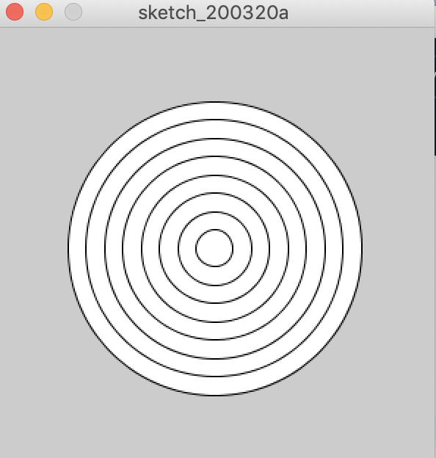
Exercise 2: Simple dartboard
Make a simple dartboard, with a few rings of different sizes
Hint: Make an array of diameters, and use that in your loop to draw the circles
Notes:
circles = [200, 175, 150, 125, 100, 75, 50, 25]
# Since we're only drawing things once, we can do everything inside of setup this time
def setup():
global circles
size(300, 300)
for diameter in circles:
circle(150, 150, diameter)

Slide 20
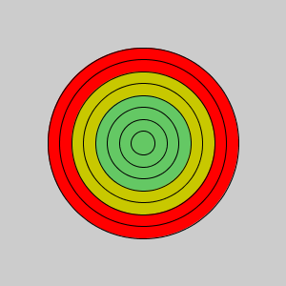
Mixing for loops and if statements
From the last example, how could we change the color of the circle when it gets bigger? Using if statements! In setup() we can add…
for diameter in circles: if diameter > 150: fill(255, 0, 0) elif diameter > 100: fill(200, 200, 0) else: fill(100, 200, 100) circle(150, 150, diameter)
Notes:
circles = [200, 175, 150, 125, 100, 75, 50, 25]
# Since we're only drawing things once, we can do everything inside of setup this time
def setup():
global circles
size(300, 300)
for diameter in circles:
if diameter > 150:
fill(255, 0, 0)
elif diameter > 100:
fill(200, 200, 0)
else:
fill(100, 200, 100)
circle(150, 150, diameter)

Slide 21
Exercise 3: Bar Graph Race
50
Make 10 rectangles that grow bigger over time.
Bonus: Make small rectangles dark red and large rectangles bright green
1

Slide 22
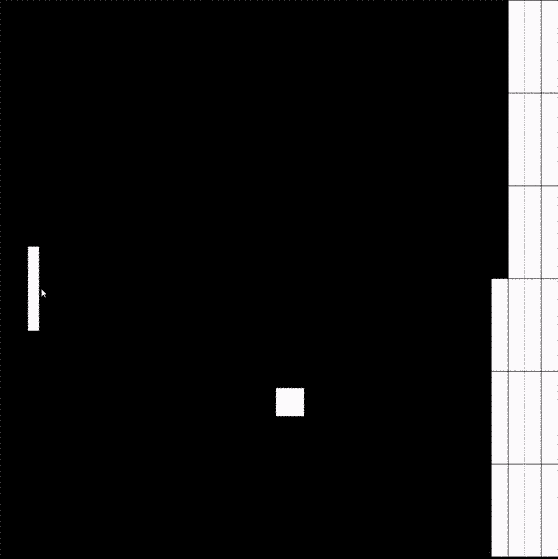
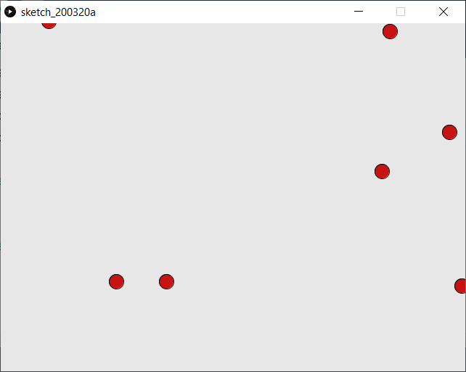
More things to do!
50
3
2

