Slide 1





Schulich Ignite 2020

Slide 2
Session Overview
Quick review of scope and global keyword
Introduction to booleans and if/else statements
Relational and Logical Operators
if wantToCode and likePizza:
# Go to Schulich Ignite!
Notes:
Today we are learning about if statements, these are known as conditionals because they have must have a condition before they are ran.
If we look below we can see an example of one,
IF you want to code AND you like pizza THEN you come to Schulich Ignite

Slide 3
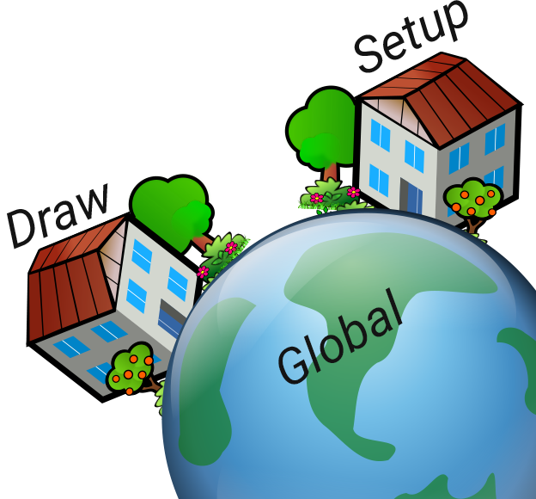
Review of scope
If we want to use changing variables in draw() or setup() we need to make the variables outside of any indentation, and then call them using global.

Slide 4

Question: Review of scope
10
Why won’t this example work?
x = 5
y = 10
def setup():
size(500, 500)
def draw():
square(x, y, 50)
x += 3
y += 1
Notes:
Because there’s no line saying global x, y to specify that you want to use x and y from outside of draw, so it thinks that X and Y do not exist

Slide 5
BOOLEANS
It’s another type of variable!
Can ONLY be True or False
Useful for if statements and checking conditions!
in_highschool = True
its_summer = False
# Don’t forget to capitalize the first letters of True and False!
Notes:
Booleans are a new type of variable, they can ONLY contain True or False. These are incredibly useful for if statements.

Slide 6
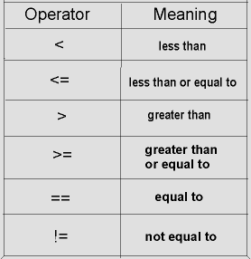
The Comparison Operators
Special operators that compares against each other to check if a statement is True or False
Don’t Forget: == (equal) is NOT the same as = (assignment)
Notes:
These are the operators for boolean logic, it’s like math! All of these are pretty self explanatory, note the way it’s formatted, no other combination of these symbols will get what you one.
And == is NOT THE SAME AS =, one is the assignment, the other is equivalence (equals)

Slide 7

If Statements
Notes:
If statements are an excellent way run some special code that may not be needed to run every single time.
Say stopping a ball would be good to be used here, previously the ball would move off the screen, because we never told it to stop.
But now we can!

Slide 8
If Statements
Want to run some code only if some condition is true? Use if statements!
# Do some code before...
if condition:
# Do some code only if condition is true!
# Do some more code after...
Notes:
So how do we use if statements?
Well, we tell the computer IF some condition, or rather some boolean is true, than we do the thing that is indented after the colon.
Remember anything that starts inside the indented part will disappear after the if statement is done.
Of course unless you make it global, and declare it outside the if statement.

Slide 9
Example
if your house is cold, then your thermostat does something (turns on your furnace)
if house_temp < 20:
furnace_on = True
if house_temp > 25:
furnace_on = False
Indented by one “tab”
Don’t forget the colons at the end!
Notes:
An example is, if your house temperature is cold, then you turn up the heat.
Look after the if, that’s the condition we are telling the computer to compare.
We are telling the computer, look at the house temperature, is it cold? If so than turn up the thermostat.
Everything that is indented will be ran, in this instants, we are turning up the heat.

Slide 10


Example: Try it out!
temperature = 36.00
hot = temperature > 25
size(640, 480)
background(255, 255, 255)
if hot:
background(252, 145, 145)
# Draw a house...
fill(0, 0, 0)
rect(0, 460, 640, 20)
rect(200, 360, 200, 100)
triangle(180, 360, 420, 360, 300, 310)
Notes:
temperature = 36.00
hot = temperature > 25
size(640, 480)
background(255, 255, 255)
if hot:
background(252, 145, 145)
fill(0, 0, 0)
rect(0, 460, 640, 20)
rect(200, 360, 200, 100)
triangle(180, 360, 420, 360, 300, 310)

Slide 11
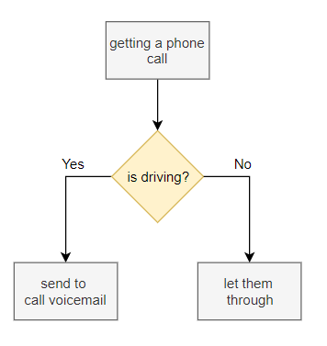
if…else Statement
if condition == True:
# do a thing
else:
# do a different thing
E.g. if you’re driving, send calls to voicemail.
else, let them through
Notes:
There’s also an else statement we can attach to it.
We are telling the computer, IF some condition isn’t true, than we do this else.
So if this doesn't work, than do this instead.
Note both of the code, one in the if and the other in the else will NEVER run at the same time
Because else ONLY happens if the first condition isn’t true.

Slide 12

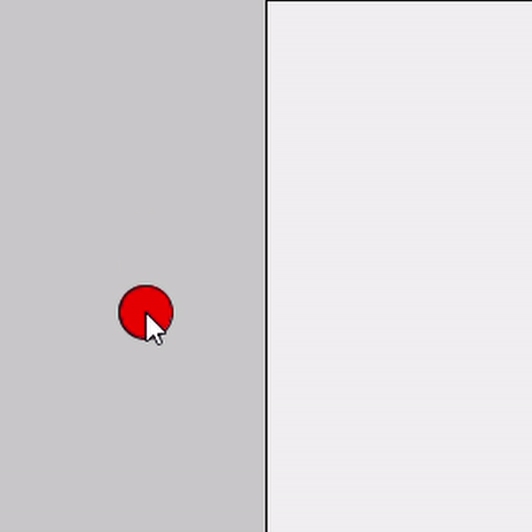
Disappearing Ball
line(250, 0, 250, 500)
if mouseX > 250:
fill(255, 0, 0)
circle(mouseX, mouseY, 30)
Notes:
So how does this all combine together?
We’ll look at 3 very similar examples
And we’ll examine the differences in each.
This is how the code is ran
Fill any shapes we draw with white.
BUT If the mouseX is past 250 than fill it red instead!, so as you can see in the gif if we pass the line it changes it to red and if we cross back it’s white.

Slide 13

Exercise 1: Teleporting Ball
Draw a circle at the top left-hand corner of the window.
The circle should move horizontally to the right hand
side of the screen until it goes out of the window and disappears.
Make the circle reappear back at the left after it moves off the screen.
Notes:
radius = 20
x = radius
def setup():
size(400, 200)
fill(255)
noStroke()
ellipseMode(RADIUS)
def draw():
global x, radius
background(0)
ellipse(x, radius, radius, radius)
if x - radius >= width:
x = radius
x += 3

Slide 14
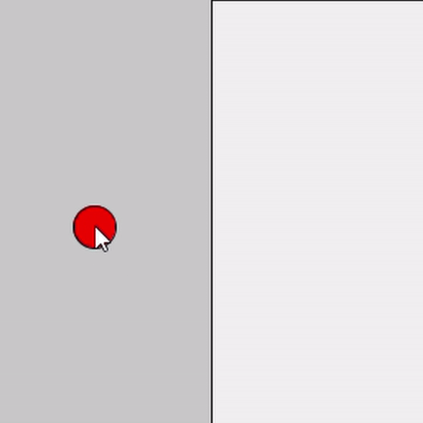
Mirrored Ball!
line(250, 0, 250, 500)
if mouseX < 250:
fill(255, 0, 0)
circle(mouseX, mouseY, 30)
else:
fill(255, 150, 150)
circle(500 - mouseX, mouseY, 30)
Notes:
This one uses an else.
If we are a cross the line, than change it to red
If we are not a cross the line than change it to blue

Slide 15

Exercise 2: Bouncing Back
Make the circle from Exercise 1 bounce and change directions when it hits an edge of the window.
Hint: Ask your mentors questions!
Notes:
radius = 20
x = radius+1
speed = 3
def setup():
size(400, 200)
fill(255)
noStroke()
ellipseMode(RADIUS)
def draw():
background(0)
ellipse(x, radius, radius, radius)
if (x <= radius or x >= width-radius):
speed *= -1
x += speed

Slide 16
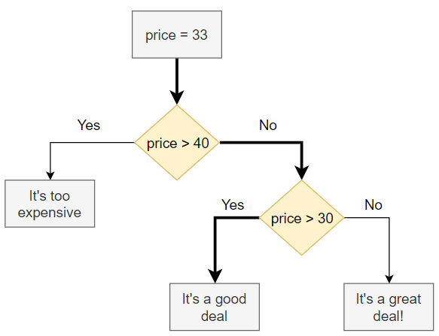
if … elif … else Statement
price = 33.00
if price > 40:
print("It’s too expensive.")
elif price > 30:
print("It’s a good deal!")
else:
println("It’s a great deal!")
You can also use multiple elif blocks in the same if statement
Notes:
You can also put an else if (called an elif).
Here you’re telling the computer if the first one doesn't work, try this, if that doesn't work try this if alll those if/elifs don’t work, then do the else as a last resort

Slide 17
Logical expressions
The statement “Programming is fun AND useful” is True, because programming is fun as well as it is useful ;)
The statement “At 22°C, water is a liquid AND water is a solid” is False, as water is not a solid at this temperature
But the statement “At 22°C, water is a liquid OR water is a solid” is True, as water is ONE of those things (a liquid)

Slide 18
Combining NOT with AND
You can combine any logical operators to do what you need
(Oh the coding you will know, oh the operations you will see!)
Do you like green eggs and ham?
like_green_eggs = False
like_ham = False
if not like_green_eggs and not like_ham:
print(“I do not like green eggs and ham,”)
print(“I do not like them, Sam-I-am!”)
Notes:
This one is more for fun
If you want, you can use multiple AND, OR and NOT statements all in the same expression
This example says if you do NOT like green eggs AND you do NOT like ham, then print the stuff below

Slide 19
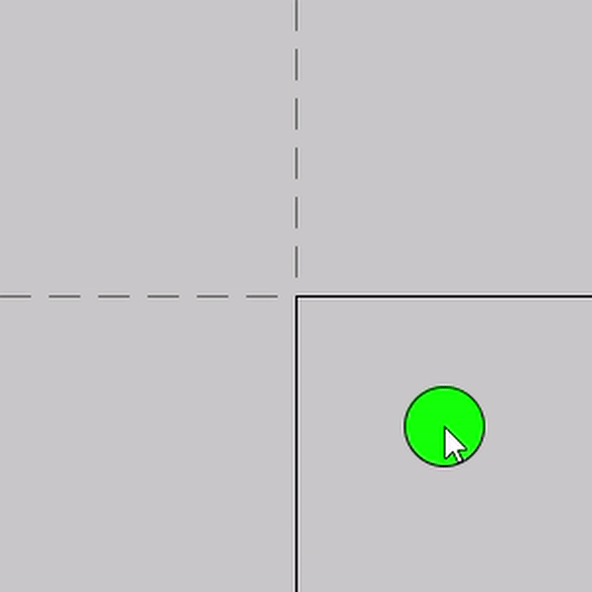
Bringing it Together
if mouseX > 250 and mouseY > 250:
fill(0, 255, 0)
else:
fill(0, 0, 255)
ellipse(mouseX, mouseY, 30, 30)

Slide 20
Example 3: different color in every corner
if mouseX > 250 and mouseY > 250:
fill(0, 255, 0)
else:
fill(0, 0, 255)
ellipse(mouseX, mouseY, 30, 30)
# How would we make the ball turn a
# different color in every corner?
# Hint: Use multiple elif blocks!
Notes:
Solution for this on the next slide

Slide 21
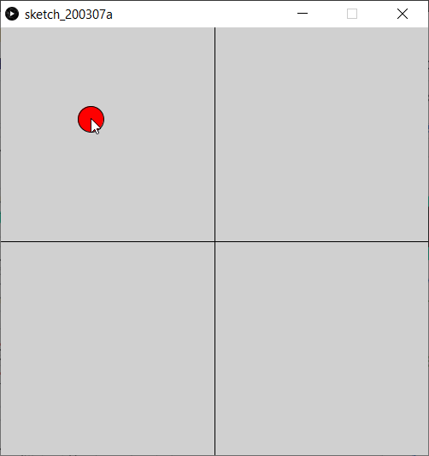
Lotsa Colours!
if mouseX < 250 and mouseY < 250:
fill(255, 0, 0)
elif mouseX > 250 and mouseY < 250:
fill(0, 255, 0)
elif mouseX < 250 and mouseY > 250:
fill(0, 0, 150)
else:
fill(255, 255, 0)
ellipse(mouseX, mouseY, 30, 30)
Notes:
Here’s an example that uses both AND and ELIF together to make lots of combinations

Slide 22
Another Special Variable: mousePressed
The variable mousePressed has the value True or False
True: You are clicking down on the left mouse button
False: You aren’t clicking down on the left mouse button
Useful when combined with if statements!
if mousePressed:
print(“The mouse is pressed now!”)
fill(255, 0, 0)

Slide 23

Exercise 4: ScreenSaver ball
50
Make the circle from Exercise 2 start in a random direction and bounce like an old screensaver.
Hint: Ask your mentors questions!
1

Slide 24
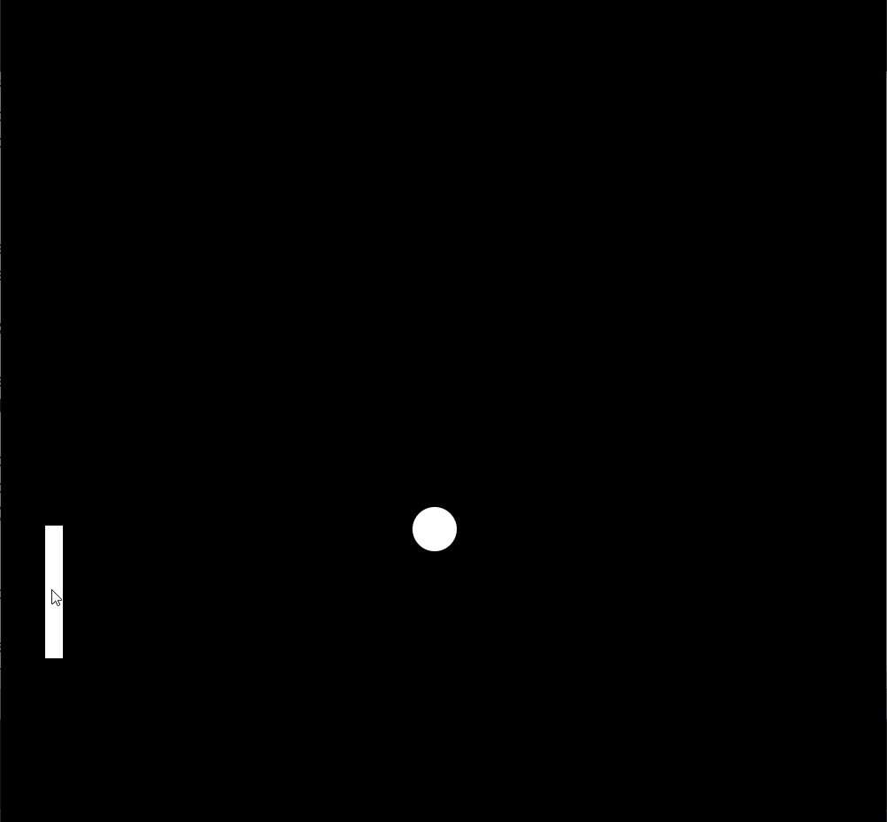
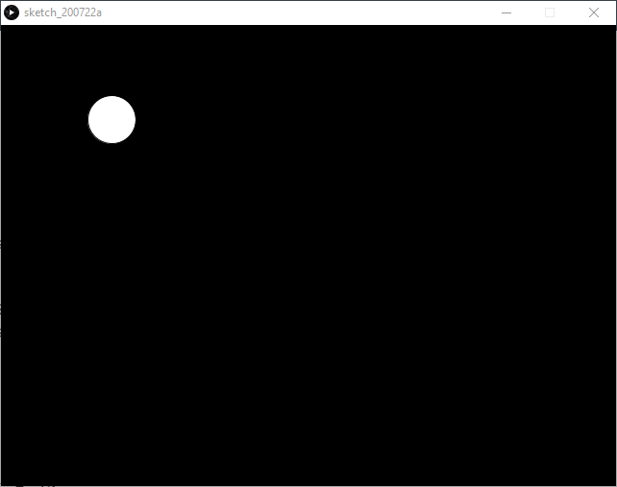
More things to do!
50
2
3

