Slide 1





Schulich Ignite 2020

Slide 2
Session overview
Arithmetic operators
Combining variables
Updating variables with themselves
Variable scope
Examples!
Notes:
Here’s an overview of the material we’re covering today.
What is a variable and different types of variables
Operations and what they do, where you’ve seen them before
Some functions very important to the Processing language, setup and draw
Introduction to if/else statements
And finally, exercises

Slide 3
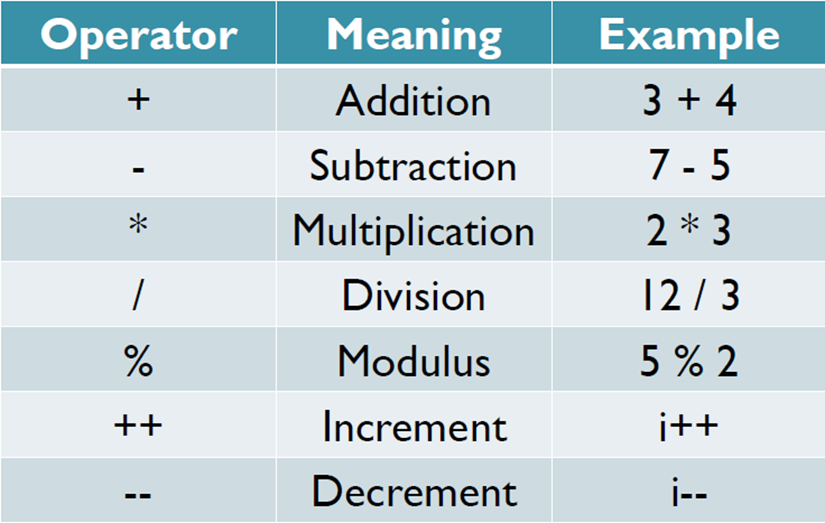
Arithmetic operators
Notes:
This slide is pretty obvious, except for modulus, increment, and decrement.
Modulus gives the remainder of a division. Ask your mentors for more about this
Integer division!

Slide 4
Combining variables
a = 20
b = 30
print(a + b) # prints 50
print(a * b) # prints 6000
d = (a + b) * 30
print(d) # prints 1500
Notes:
You can mix variables together, after all variables are containers for data,
As seen here a and b contain integers, so if you look inside each variable

Slide 5
Updating a Variable...with itself!
= symbol is the assignment operator
The left-hand side is set to whatever the right-hand side is (and NOT vice versa)
height = 170
# Next year, you grow 5 cm
height = height + 5
print(height)
Notes:
convert this in lec 1 but reinforce and reiterate
‘=’ or the equals sign is called the assignment operator, because you are assigning a value to the variable.
If you don’t put the assignment operator (equals) than you do all this hard math work and just peace out.
The left hand side is the variable that changes, anything on the right hand side is calculated then whatever that outcome is is assigned to the variable.
Note there is a slightly different version with two equal signs, they are not the same but we’ll see that one later.

Slide 6

Question
10
Is it okay to declare variables inside the draw function? Why or why not?
def draw(): # draw() repeats forever, until the program is stopped
background(204, 204, 204)
x = 10
x += 1
ellipse(x, 100, 50, 50)
# Will the ellipse move in the positive x direction?
Notes:
No, you cannot have variables inside of draw().
They will get overwritten/recreated every single time draw() runs.
This is to introduce the concept of variable scope

Slide 7
Variable Scope & Global Variables
Variable scope says how long variables last for, and what can see them
Variables started inside the indentation disappear after the indentation
Variables that are not indented are global variables
Notes:
width_height = 10 # The width/height of the square
def setup(): # Setting up the screen
size(500,500)
def draw(): # Drawing each frame
global width_height # Get the global value of width_height
x = 25 # Create local x variable
y = 25 # Create local y variable
width_height += 1 # Add 1 to the global width_height on each draw
square(x, y, width_height) # Draw square at x,y with current width_height

Slide 8
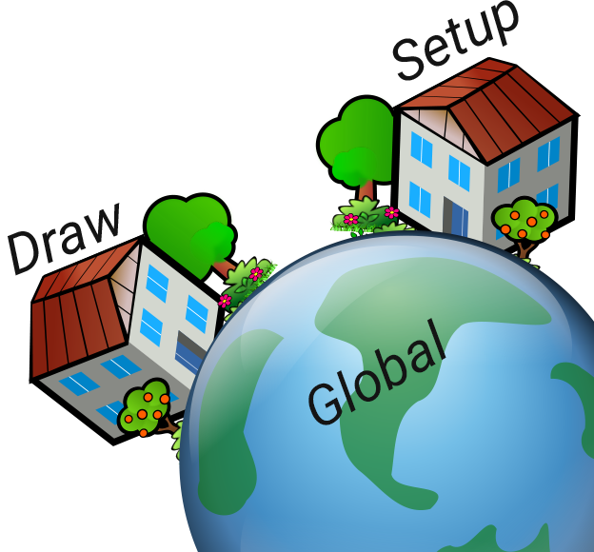
An Analogy to Help
Variable Scope Analogy
If each function is a house, then variables can only talk to variables in the same house
To talk to variables outside their house, they need to open the window and call them (using global)
Notes:
You wouldn’t break into your neighbours house to talk to them… right?

Slide 9
Scope example
width_height = 10 # The width/height of the square
def setup():
size(500, 500) # Make our window be 500 x 500 pixels
def draw():
global width_height # Get the global value of width_height
width_height = width_height +1 # Add 1 to the global width_height on each draw
square(25, 25, width_height) # Draw square at 25,25 with current width_height

Slide 10
Shorthands for lazy programmers
x += 5
  Means x = x + 5
  += can be used to increase x by any number
    e.g. x += 75 will increase x by 75
x -= 12
  Also means x = x - 12
  -= can be used to decrease x by any number
    e.g. x -= 42 will decrease x by 42
Notes:
Programmers are lazy.
Programmers hate typing, if we could do it with mind, we would.
I mean the actual reason is to remove chance of misspelling something and screwing it up.
So to increase a variable by some number or variable we use variable name plus equals, the amount we want to increase it by.
This is exactly the same as typing in x = x + 1 but one it’s faster to type and two you can’t miss spell x…. Somehow…..
There’s also a subtraction version, exactly the same thing but subtraction.

Slide 11
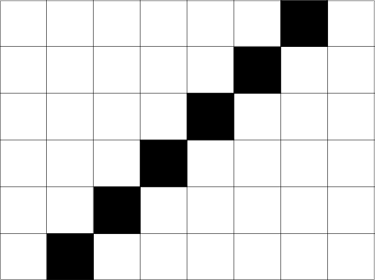
Exercise 1: Operators
Let’s draw a diagonal square!
(Don’t worry about drawing the grid here)
Create an variable xpos and set it to 10. Draw a square with xpos as the x-coordinate
Increase the value of xpos by 10. Draw a new square.
Increment the value of xpos by 40. Draw a new square again.
What do you notice as the x value increases?
Now, try to make a diagonal square pattern! How could you change the x and y values to change the location of the square so they line up just right?
Notes:
xpos = 0
ypos = 440
def setup():
size(640, 480)
background(255, 255, 255)
def draw():
global xpos, ypos
fill(0, 0, 0)
square(xpos, ypos, 40)
xpos += 40
ypos -= 40

Slide 12
Using Variables to Change Other Variables
Variables can change (and usually do!), that’s why they’re called variables.
Make a new variable named “speed”
Change the X coordinate of the ball with speed
speed = 3
x += speed

Slide 13
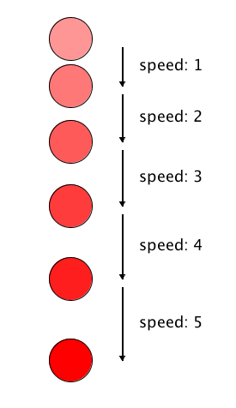
Bonus: Adding Gravity
In real life, the longer a ball falls, the faster it falls!
The speed of the ball
gets faster
y += speed
speed += 1

Slide 14
Writing Text Across the Screen
How would you make text move across your screen, while increasing the size?
textSize(size)
text(“Hello”, x, y)
x += 3
y += 14
size += 10

Slide 15
fading colors
What if you wanted to make a shape fade from one color to another?
// This makes the color “more green” as time goes on
fill(150, green, 150)
ellipse(100, 100, 50, 50)
green += 1.5
Notes:
Color will slowly become more and more green
Color stops changing when green becomes bigger than 255, since max value for the color is 255

Slide 16
Exercise 2: Drawing
Set the screen size to be 400 by 500
Draw a circle (i.e. an ellipse with equal dimensions)
at the top left-hand corner of the window.
Write a program to make the circle move horizontally toward the right-hand side of the screen until it goes out of the window and disappears.
Write a program to make the circle move diagonally down to the
bottom right hand side of the screen until it goes out of the window and disappears.
Bonus:
Write a program to make the circle gradually change from one red to blue.
Notes:
# Circle starts at x = 0 and y = 0
xpos = 0
ypos = 0
# Circle starts being fully red (255) and with no blue at all (0)
red_color = 255
blue_color = 0
def setup():
size(400, 500)
def draw():
global xpos, ypos, red_color, blue_color
background(255, 255, 255)
fill(red_color, 0, blue_color)
circle(xpos, ypos, 40)
# Move the circle 2 units left and 2 units down
xpos += 2
ypos += 2
# Make the circle color become less red and more blue as time goes on
red_color -= 2
blue_color += 2

Slide 17
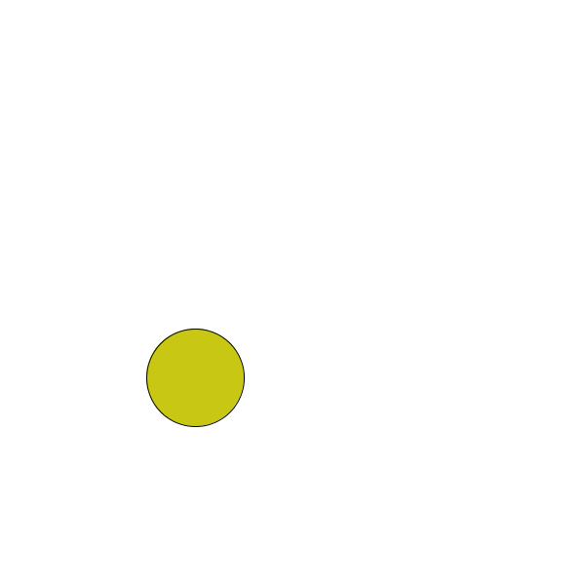
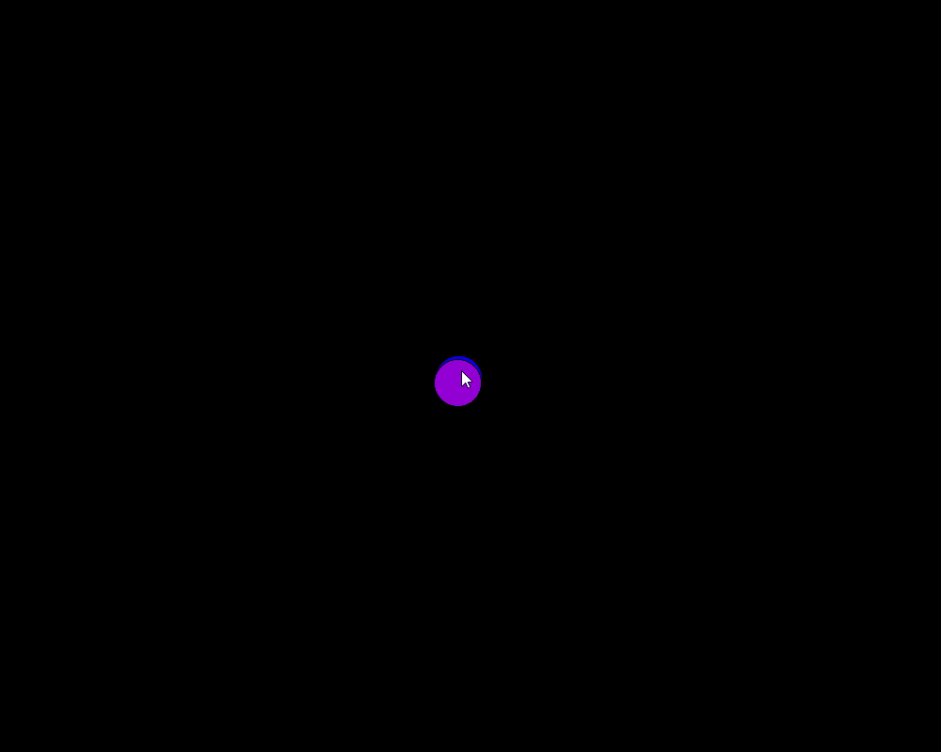
More things to do!
When submitting, please include the question number too!
50
1
2
Notes:
Hint, you can make the ball bounce using sin:
As n increases, sin(n) goes between 1 and -1
Multiplying sin(n) by 200 to make its range be between 200 and -200 instead
Adding 200 to it so that the center of its bounce is at y = 200 instead of at y = 0
50 ignite points each

Slide 18
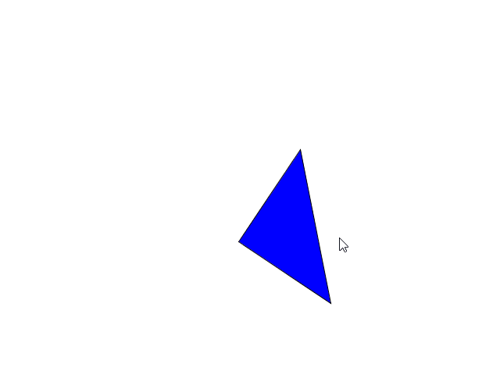
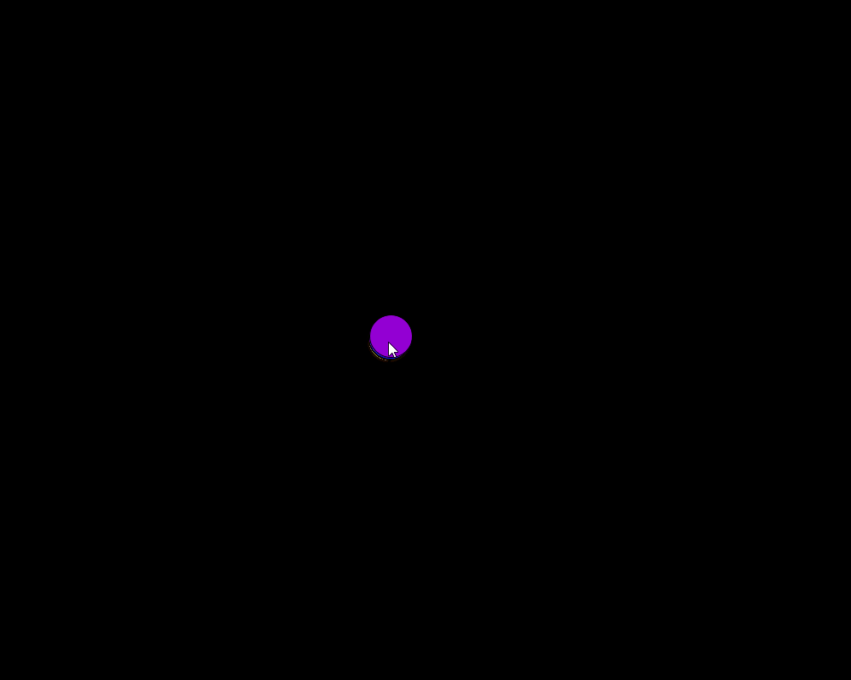
More things to do!
50
3
4
Notes:
50 ignite points each

