Slide 1
Schulich Ignite 2020
Notes:
#Some intro
People who feel more comfortable with coding go to [choose side], and you’re less comfortable [other side]
You can move to another side at any time it doesn't matter, and if you want to stick with friends that’s cool too.
We are just having more mentors on one side for the people who would like to have more 1 on 1 have the opportunity to get it.
//Encourage people to talk to their mentor even when the lecturer is talking, this is more a workshop anyways.

Slide 2
Program Overview
Six interactive and fun sessions
Exercise and project oriented approach
Creativity is highly valued
Workshops are meant to give students a hands on experience with programming
Notes:
We’ll learn processing, which gives us an easy way to display stuff on the screen, everything else we do is raw programming and very applicable to any other programming you do. We’ll do this over 6 lecture then we’ll have 2 more to work on your own projects, maybe a game or a piece of art or maybe even graphing programs. This will be very hands on you’ll be practicing nearly everything we mention here.

Slide 3
Content overview
Session 1: Variables, Mouse Movement, setup() and draw()
Session 2: Operators, Moving objects
Session 3: If-Statements, Logical Operators
Session 4: Arrays, Loops part 1
Session 5: Loops part 2
Session 6: Functions
Notes:
More detailed version of our things, we’ll cover this stuff so don’t worry!

Slide 4
Content slides
Website: https://schulichignite.com/
Here’s where you can see all the content slides for all of our sessions
Examples also live here!
Notes:
Website, if you’re behind in the slides, you can get them here!

Slide 5
Ignite points
Points that can be collected by students through solving in-class questions, submitting social media weekly challenges or submitting projects
A link to the spreadsheet containing all the Ignite Point totals, rules and details:
https://docs.google.com/spreadsheets/d/1hSNFLSHZPwLeb6MjDPZ_KntGLAOWSQN5qY9DEahpycg/edit?usp=sharing
Notes:
More info about ignite points in the linked spreadsheet

Slide 6
COLLECTING IGNITE POINTS & PRIZES
Action | Points Awarded
In-class question | 10-20
End of session exercise | 25-50
Weekly Challenge | 50
Project | Up to 250
Placement | Prizes
First place | $25 Amazon eGift Card
Second place | $20 Amazon eGift Card
Third place | $15 Amazon eGift Card

Slide 7
In-Class QUESTIONS & END OF SESSION EXERCISES
Slides with this logo have questions that can be answered for points!
Some in-class questions will be worth Ignite Points, and they answered directly on the Zoom chat. The first to correctly answer an in-class question receives Ignite Points.
To answer end of session exercises, you will need to submit a processing file as your answer to this submission form: https://docs.google.com/forms/d/e/1FAIpQLSe50oeWTDWdCIGB2tJMd9ieg8e6uoIjgAK3TMIGUSIEdCibYg/viewform?usp=sf_link
Notes:
Participation is optional but highly encouraged for both

Slide 8
SOCIAL MEDIA Weekly Challenges
Those are challenge exercises that will be posted on our Instagram and Facebook pages at 5:00pm every Wednesday. The deadline for each challenge will be the following Wednesday at 5:00pm. Please submit your weekly challenges here:
https://docs.google.com/forms/d/e/1FAIpQLSe50oeWTDWdCIGB2tJMd9ieg8e6uoIjgAK3TMIGUSIEdCibYg/viewform?usp=sf_link

Slide 9
SOCIAL MEDIA Weekly Challenges
Notes:
An example of what the weekly challenges looked like in the winter. Will probably look a little different in the summer sessions, but they will look something like this

Slide 10
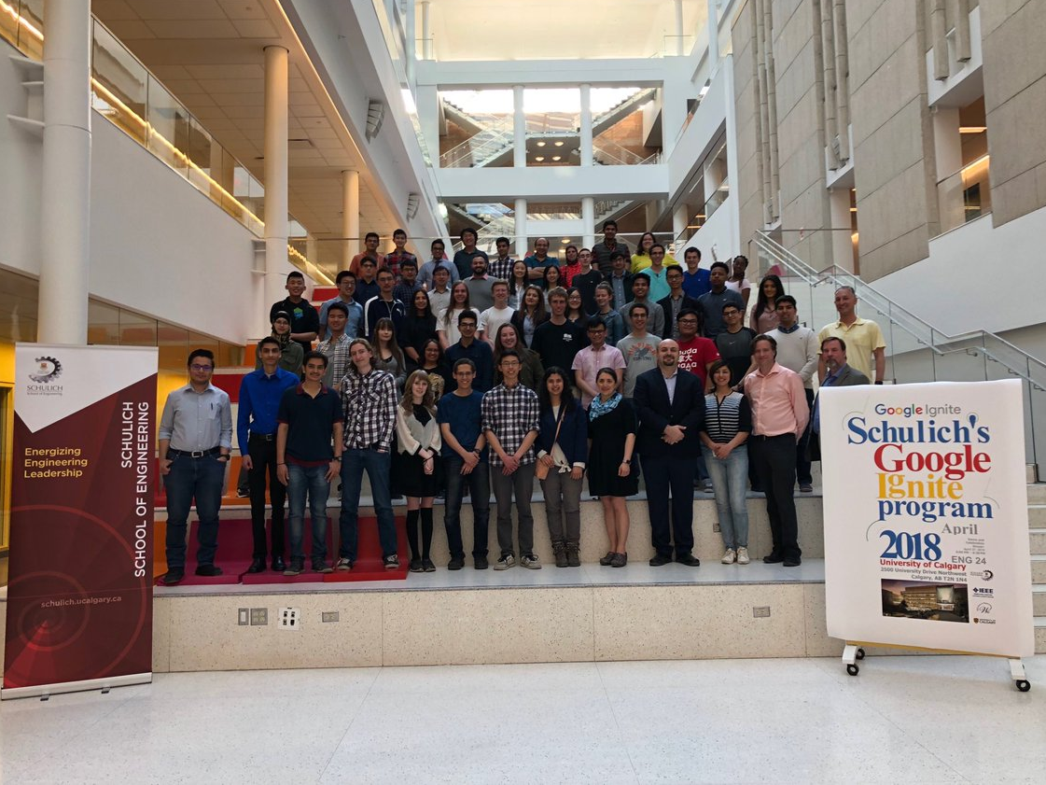
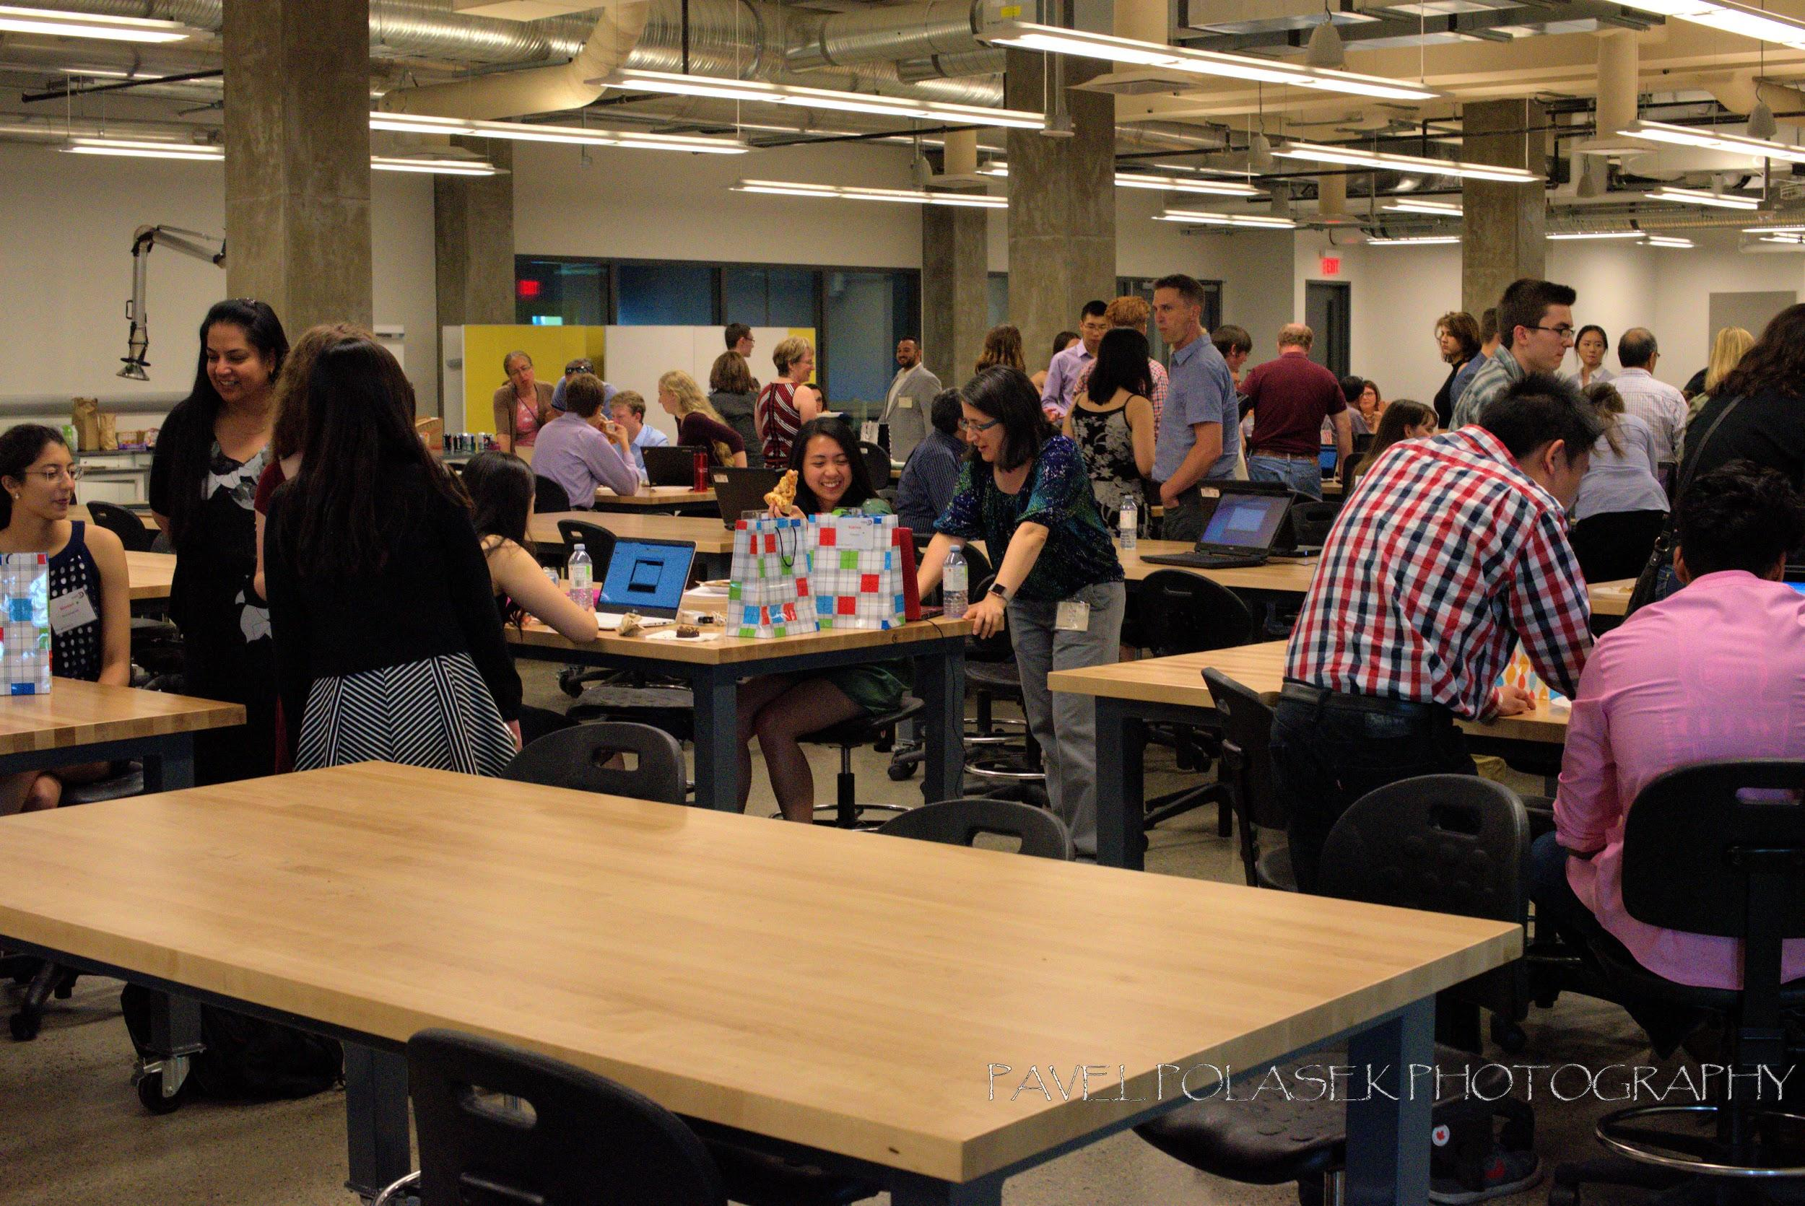
Notes:
After the 8th session everyone we’ll have a end of program dinner to demo our final projects, come by we’ll get food (prob) and even if you don’t finish come by and show off what you got, we know it’s not easy and knowing you put in the work makes our jobs of mentor so much more rewarding.

Slide 11
What is Software Engineering and its benefits?
Notes:
If Monshipour.present():
Monshipour.speech()

Slide 12
ICEBREAKER
Time!

Slide 13
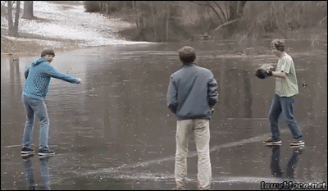
Icebreaker activity with your group!
Time for introductions! With your group answer the following questions:
What’s your name?
What is your favorite smell?
Name something about programming that interests you
Talk to your mentors?
Notes:
Approx 5 minutes
Get them talking, comfortable it’s going to be road ahead

Slide 14
What is the difference between humans and computers?
Notes:
Imagine I had a person and a robot standing next to me. First i turn to the human and i ask them to grab a pen from the room above us. So what would they do? Well first they walk out the door, down the hallway, up the stairs down the upper hallway, into the door up there and past any human to grab the pen. They then repeat this whole process to come back to me and pass me the pen.
Now I turn to the robot and ask it to get the pen, what will they do?
The robot will jump through the roof, walk over to the pen crushing any humans and tables in its path. Grab the pen bust through the floor landing on top of me flattening my body. Why did it do that?
Well because I didn’t tell the robot not to break property. I did not tell it to avoid people. I did not tell the robot to put the pen in and my hand and not on top of my pancake of a body. This is the fundamental property of computers, they don’t understand these implicit things such as avoid people. They do things Exactly how we tell them. But why do we need the robot then if a human is so much easier to work with? Well how many times could i get the person to run up and down the stair before they get tired? Could they do it 24/7? Do they need breaks? See that’s the beauty of computers, they will work constantly never taking a break, never complaining. Always doing the exact same thing always predictable. So for this program we will learn the basics of talking to computers so that we can make it do what we want, and not bust through a wall like the kool-aid man. This is why computers are useful, once you’ve told it what to do, you never have to tell what to do again.

Slide 15
Let’s Get Started!
Notes:
Processing Website Linked to the Image

Slide 16
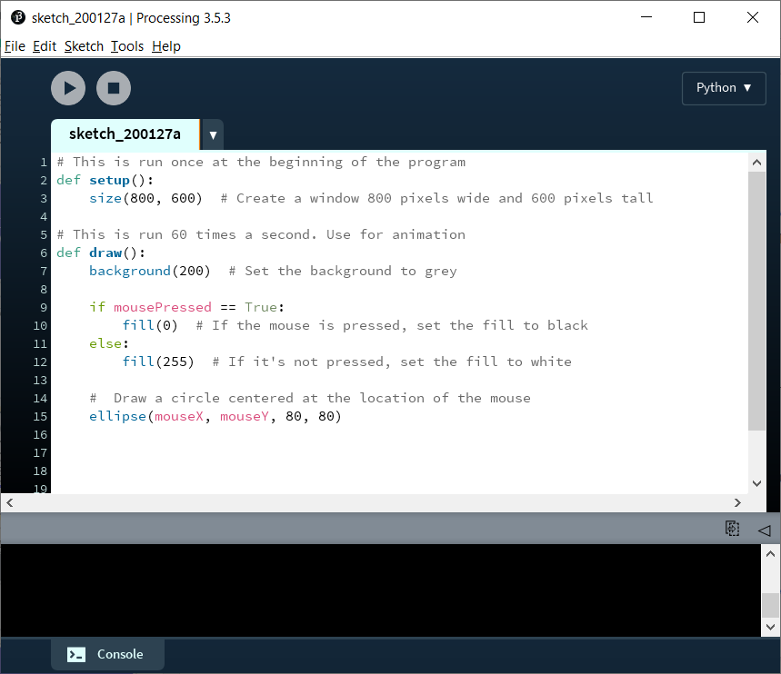
What is processing?
Beginner-friendly programming language
Free to download! (https://processing.org/download/)
We will be using the Python based version
Disclaimer: Technically started as Java and converted to Python. Some features may differ
Lots of references available at https://py.processing.org/reference/
Notes:
Processing is a good way to learn programming, it handles some complex stuff like displaying things on the screen. Even though we’re using Python, everything you learn here is applicable when you learn and work with different languages.
The syntax, or rather the punctuation of the language may change but the what you can do and the way you think about how to talk with computers remain relatively the same.

Slide 17
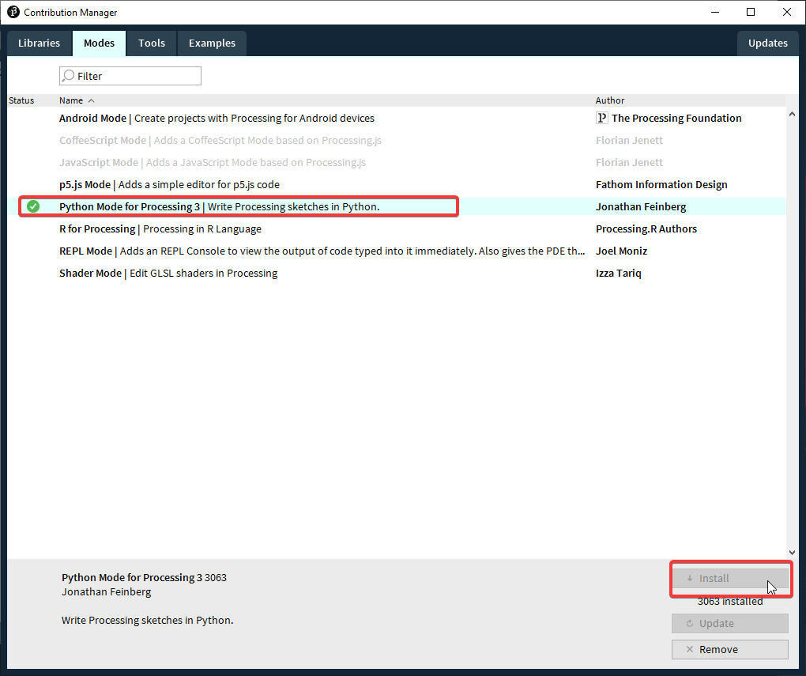
Processing python mode
After downloading processing, we need to install the “Python mode”
Click the button on top right to add a new mode
Select “Python Mode for Processing”, and click “Install”
Notes:
Demonstrate how to download and run processing, and also emphasize that you must be in Python mode

Slide 18
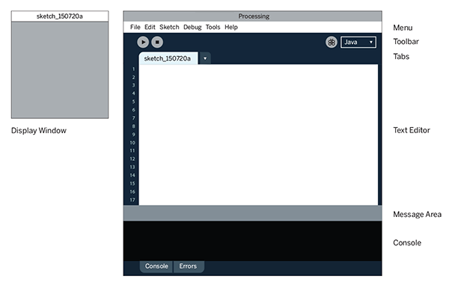
Processing’s Structure
Start
Stop
Notes:
Point out: Start: It’s how you run your code
Stop: It’s how you stop your code (or the x button on the display)
Text editor: this is where we’ll be placing our code
Console: Any println statements goes here, println will be explained later.

Slide 19
The Basics!
Notes:
Why waste time say lot word when few word do trick

Slide 20
Setup
For now, all code goes inside setup
def setup(): down here and here
1 Single “Tab”
Notes:
Setup, the place where you setup your code. Pay attention to indents! One single tab for all of the code that will be in setup

Slide 21
Tell me something!
print prints words to the console (the little black box)
Very useful to see that’s going on in your program.
Comments: Anything after # is ignored as a comment until the end of the line. Very useful for programmers!
Notes:
Print line or Print L N (careful of that it’s an l not an i) is a basic way of letting the computer talk to us.
# Type println(“hello [name]”)
First we type the command we want the computer to do, in this case it’s println (line)
But it needs something to print, how are we going to tell the computer this?
Well see these round brackets? This is where we put anything we want to give the computer, which you can see is “hello”
But why the double quotations? Because computers are very picky about how you give them different types of information, putting the quotation marks beside it tells the computer it’s a word and not something like an number (yes computers are that dumb)
The semicolon at the end tells the computer, stop looking for a command this is all of it right here
# Run code and see show how it prints out “hello [name]”
Comments is prefixed by # and then anything you want to type, it signals to the computer that you are not talking to it but yourself

Slide 22
Size()
Drawing needs a screen to draw on.
Set the size with size(width, height)
# Make the screen 800 wide and 600 tall size(800, 600)

Slide 23
Let’s Draw Something!
rect(x, y, w, h)
x : x-coordinate of the top left corner y : y-coordinate of the top left corner w : width of rectangle h : height of rectangle
(x,y)
Height
Width
Notes:
Words are cool but what about like a picture? What about shapes?
Let’s do a Rectangle or Rect let’s draw a rectangle that’s in the middle of the screen with size of 100,100
Explain parameters
Don’t forget to explain size as well, type in size(500,500); or something Huh that’s a square, well i wanted a rectangle? I wonder how do i change it to make it a rectangle?
Play around with the parameters for a bit and make new rectangles
Encourage explorations for themselves.
Also show how it goes x -> and y from bottom to up, it’s weird like that

Slide 24
Another shape
ellipse(x, y, w, h)
x : x-coordinate of the centre of the ellipse y : y-coordinate of the centre of the ellipse w : width of the ellipse h : height of the ellipse
(x,y)
Height
Width
Notes:
Ellipses are either a circle or an oval.
Note that ellipses are in the center while rects have the coords in the top left

Slide 25
The other Shapes
point(x, y)
line(x1, y1, x2, y2)
triangle(x1, y1, x2, y2, x3, y3)
Ask your mentor to know more!
Notes:
These are other shapes and things, you can ask your mentors about these shapes about what you put into them.
And Mentors don’t forget the reference page!

Slide 26
Colours And exercise
fill(r, g, b)
r : Red amount g : Green amount b : Blue amount
NOTE: All colour amounts must be between 0 and 255
Notes:
My grey rectangles are kinda lame, how do we add colours? Well fill is the solution! We pass it 3 numbers, some amount of red, some amount of green, and some amount of blue.
Because of computer things it’s a value between 0 and 255 where 255 is maximum colour Just like in grade 2, with red, yellow, blue you can mix these colours to get any other colours!
Try this feature out and draw something more complex, here are some examples you could try drawing.
~15 mins

Slide 27
Try it Yourself!
Choose one of the following to draw (10 mins):
Draw a house
Draw a snowman
Draw a car
Draw a robot
Make up your own!

Slide 28
Variables
Notes:
Variables are containers for things, they hold something inside. This is much like a box.

Slide 29
Variables
age = 23
Has a name, what you’re calling it
It stores a value, the thing it contains
Useful tip: variables also have a type, what it contains (Number or text)
Name
Value

Slide 30
Integer
As you guessed an integer is just an… integer
(Therefore, does not include decimals)
This includes positive and negative numbers
SYNTAX:
age = 19
Notes:
Integers! I hope you know them because they are just whole numbers, be it positive or negative. To tell the computer this variable is an integer you type “int” as the type Integer.
Things like 4, -6, 1 billion are all valid, but things like 1.1 is not.

Slide 31
Float
Use this for all of your decimal dreams
This also include positive and negative decimals
SYNTAX:
salary = 3000.29
Notes:
Float, a strange name but they contain any number you can think of! 1 trillion, -3.7, 3.1415
To tell the computer it’s a float we type float as the type name.

Slide 32
String
Fancy name for text (or a string of letters)
All you do is wrap the text in quotation marks (you can use “ or ‘, as long as it’s the same on both sides)
SYNTAX:
first_name = “janice”
last_name = ‘smith’
We’ll be using double quotes (“)
Notes:
Strings, or otherwise known as a “String” of characters. These are words, sentences and even entire paragraphs.
It tells the computer what you see here is just words.
Sadly there are no negative strings because, what does that even mean? Interesting note for words you must use double quotations because the computer kinda thinks its the name of another variable otherwise.

Slide 33
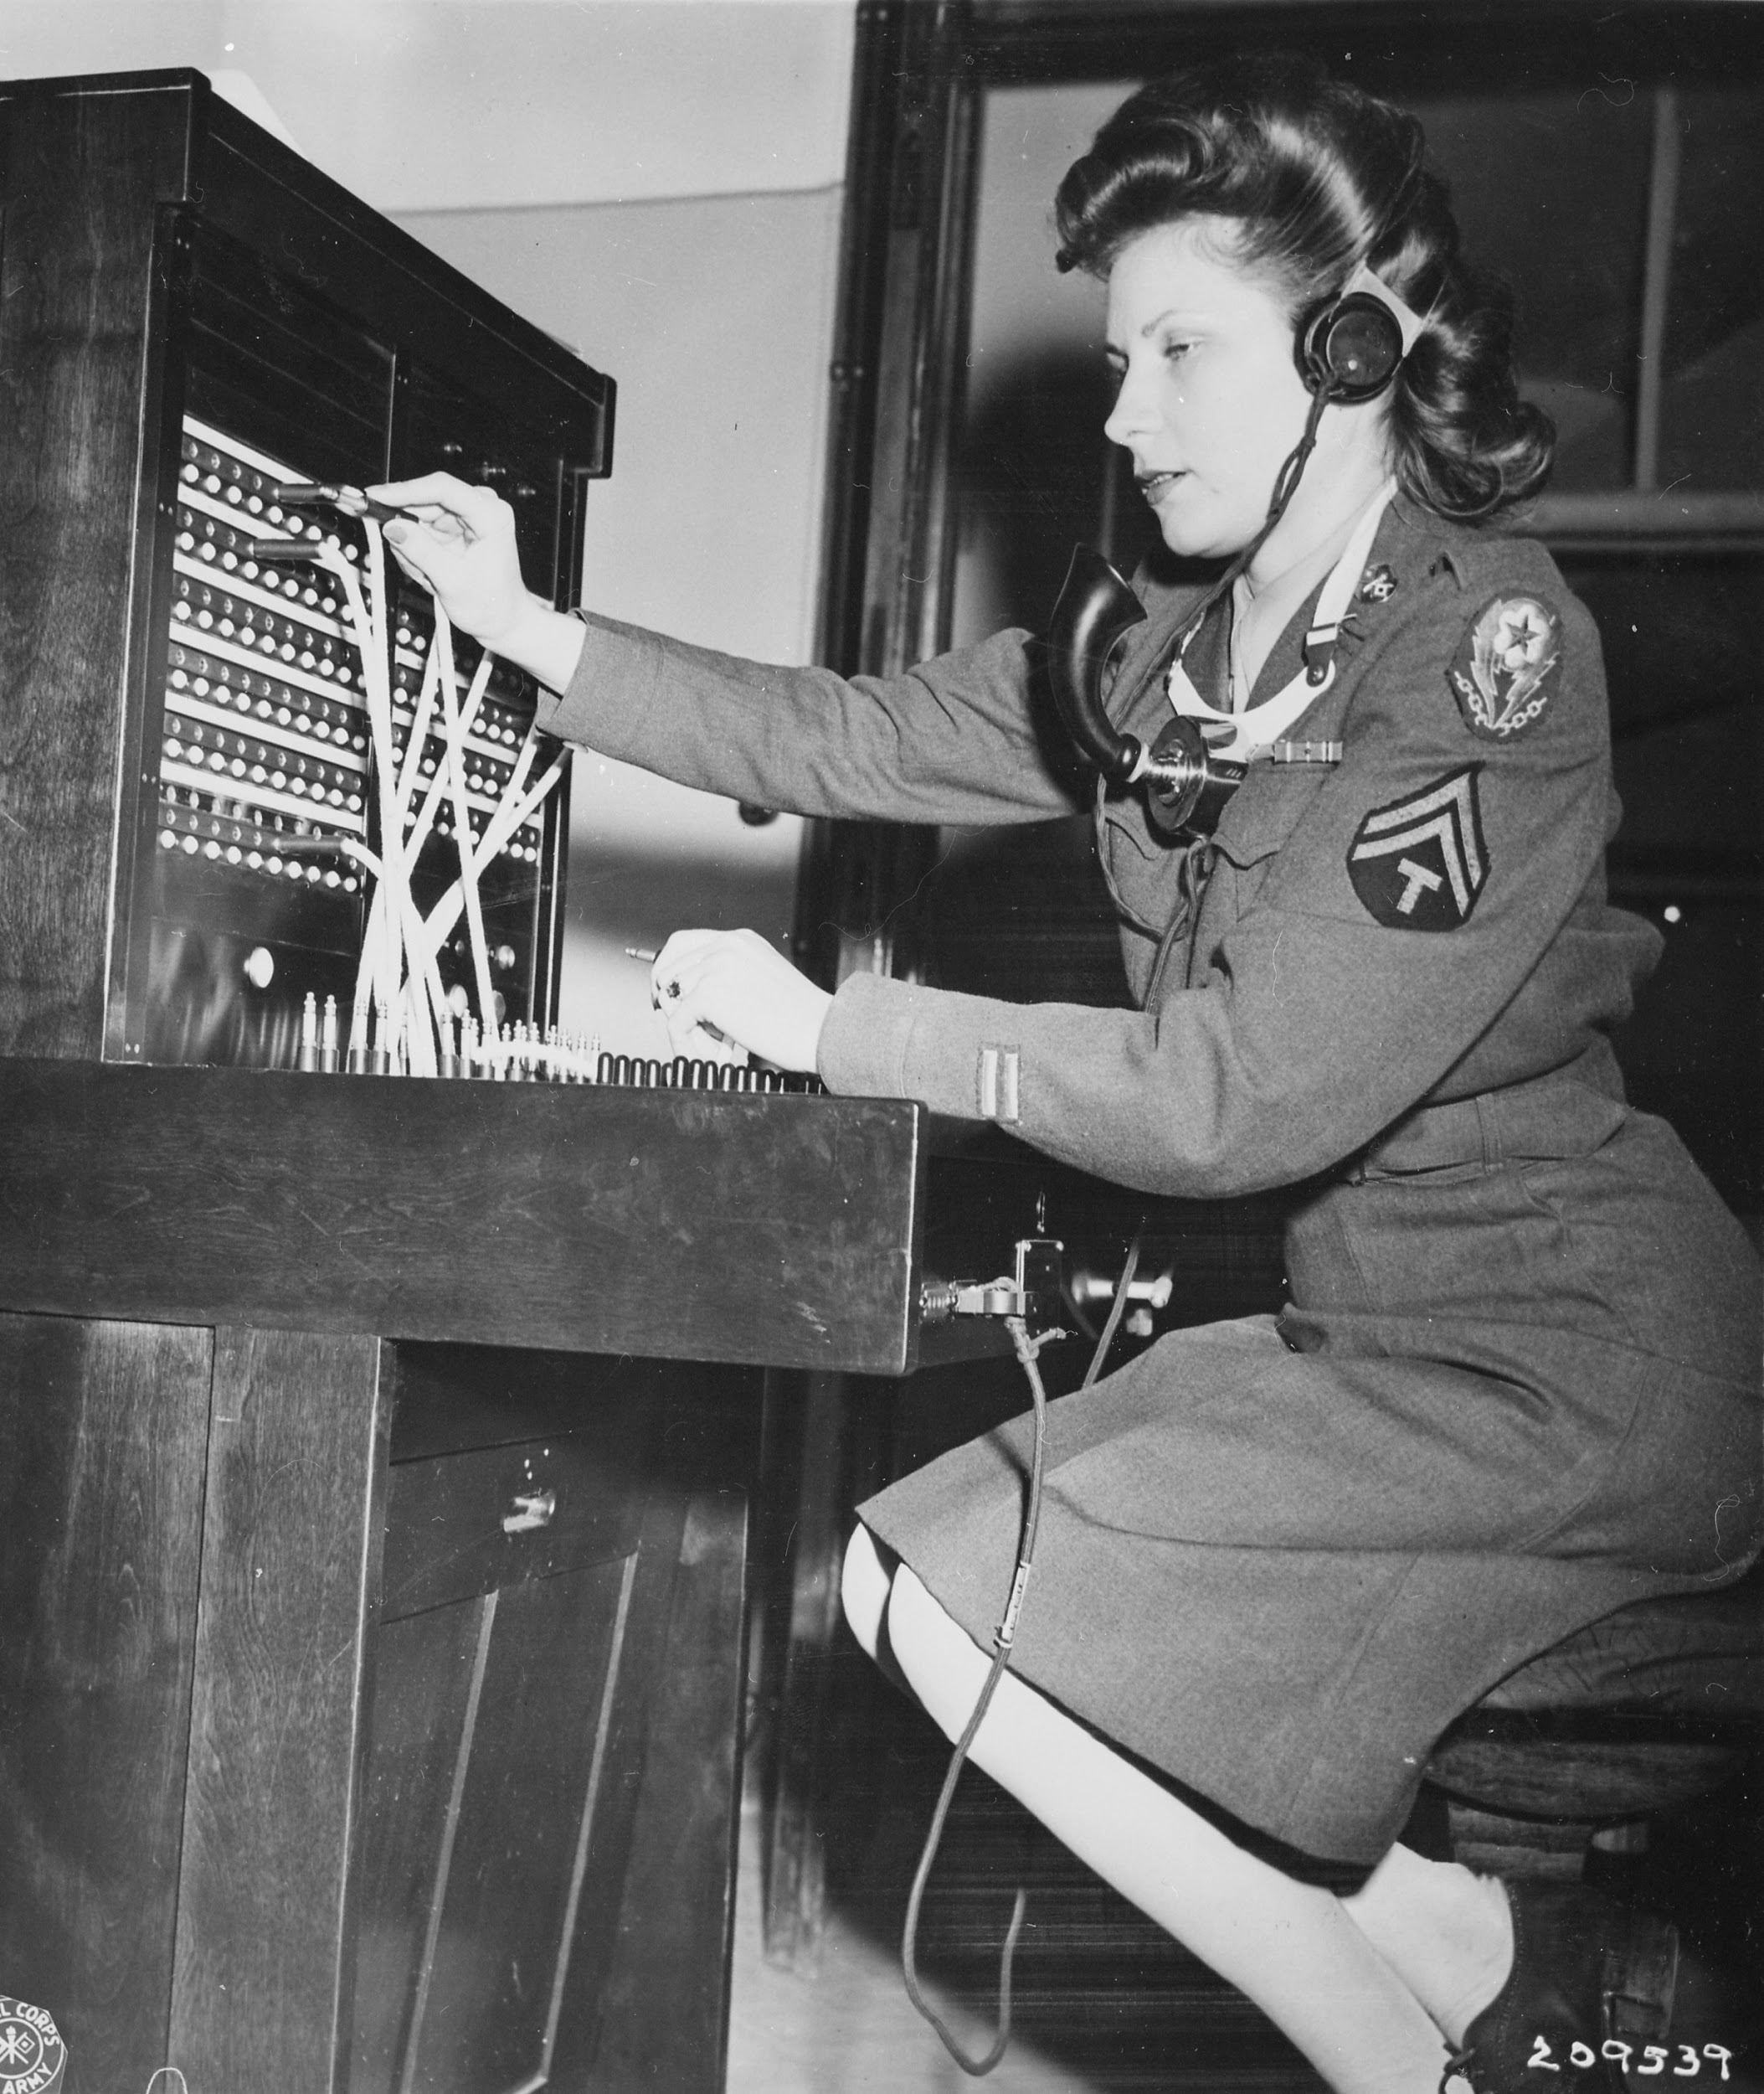
Operators*
*Not a phone operator
Notes:
I have a confession to make everyone…. It’s math...

Slide 34
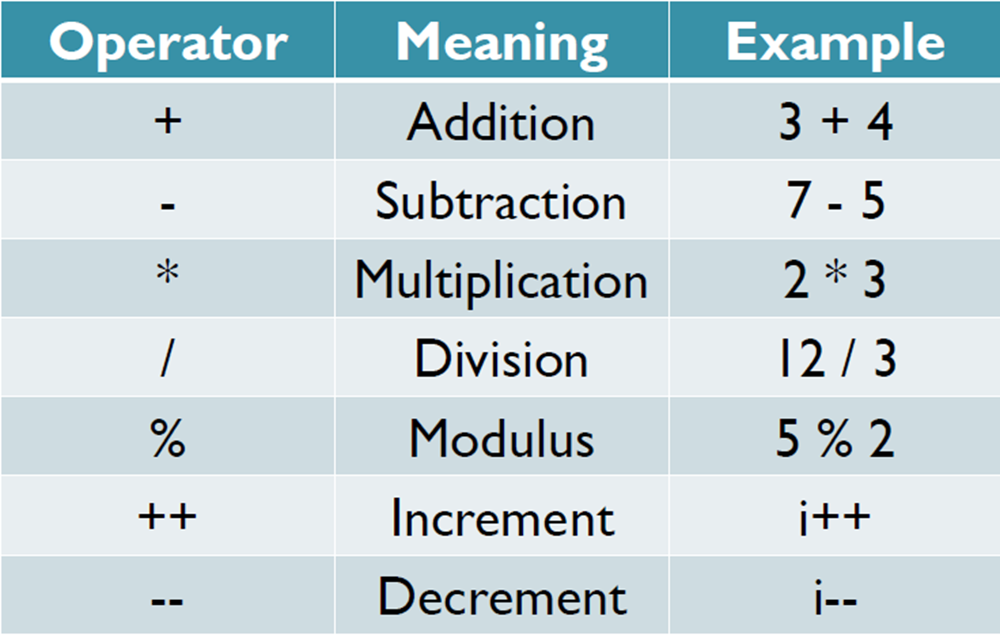
Arithmetic operators
Notes:
This slide is pretty obvious, except for modulus, increment, and decrement.
Modulus gives the remainder of a division. Odds are that you’ll never use it, but ask your mentors for more info about this if you’re curious

Slide 35
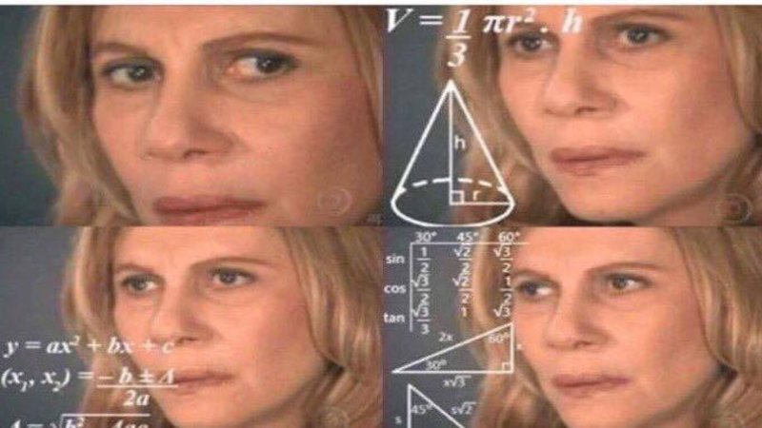
Let’s do some Quick maths
When you have to do math to program a computer to do math so you don’t have to do math
Notes:
Show how to do some math in processing
Also do math between variables

Slide 36
What if you set a variable to...itself?
What happens when you do
bob = 5 bob = bob + 2

Slide 37
Lets put these variables to use!
Let’s make a moving ball!
def draw():
# code goes here
Interesting variables already given:
mouseX: your mouse’s X coordinate
mouseY: your mouse’s Y coordinate
Notes:
Draw is ran right after setup, unlike setup it’s continues to go in a cycle forever.
So setup is good for setting up your code, like setting the size of the window.
And draw is for drawing your code.
# Make a moving ball
You can see that the ball has a trial of other balls behind it, why is that?
Because what the computer is doing every single time it’s running that code is placing a new ball right on top of the old ones,
After all I only told it to draw a ball at these coordinates and with these sizes nothing more.
So to solve that we use background(R,G,B); which have parameters just like fill but instead does the background.
Lastly MouseX gives your mouse’s X coordinate and moustY gives your mouse’s Y coordinate
I wonder what happens if you substitute these variables into your rectangle’s X and Y coordinate spots

Slide 38
Background
background(r, g, b)
r : Red amount g : Green amount b : Blue amount
NOTE: All colour amounts must be between 0 and 255
Notes:
My grey rectangles are kinda lame, how do we add colours? Well, fill is the solution! We pass it 3 numbers, some amount of red, some amount of green, and some amount of blue.
Because of computer things it’s a value between 0 and 255 where 255 is maximum colour Just like in grade 2, with red, yellow, blue you can mix these colours to get any other colours!
Try this feature out and draw something more complex, here are some examples you could try drawing.
~15 mins

Slide 39
END OF Session Exercise - Try This!
Go back and finish your drawing
Use both mouseX and mouseY to make a ball follow your mouse around the screen
Draw a rectangle with the top-left corner at the coordinates (100, 200), and make the bottom-right corner follow the mouse
Notes:
def setup():
size(400, 400)
def draw():
background(60, 120, 220)
fill(255, 160, 170)
rect(100, 200, mouseX - 100, mouseY - 200)

Slide 40
More Things You Can Do!
25
Notes:
25 ignite points each
Link to submit in first few slides

Slide 41
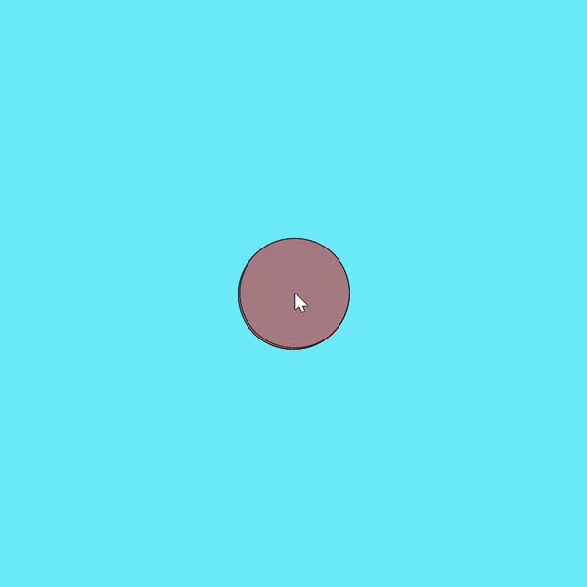
More Things You Can Do!
50
Notes:
50 ignite points each
Link to submit in first few slides

